Slide 1


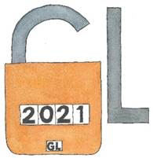

In 5 minutes:
Survey motivation,
history and
poster presentation
23rd International Conference on Grey Literature - Digital Transformation of Grey Literature: Exploring Next Generation Grey

Slide 2

Every document born grey.
It may be unusual then not to have Grey Literature in an institution.
It is much more probable that information professionals are not aware they are dealing with Grey Literature.
23rd International Conference on Grey Literature - Digital Transformation of Grey Literature: Exploring Next Generation Grey

Slide 3


The possibility of a lack of awareness on Grey Literature made us think about a survey on this topic.
At a first step, we imagined two separate surveys:
- one for academic and research libraries (which more likely know Grey Literature)
- another for all the other libraries.
Afterwards, we realized that a single survey might be more effective.
23rd International Conference on Grey Literature - Digital Transformation of Grey Literature: Exploring Next Generation Grey

Slide 4

17
UN 2030 Agenda
17
Objectives
Once decided for a single survey, our concern became how to obtain the engagement of
non-academic and non-research libraries.
We looked for a popular topic that is linked to Grey Literature:
the UN 2030 Agenda for Sustainable Development 17 objectives.
By using this big and important frame we were, finally, able to deal with Grey Literature with every kind of library.
23rd International Conference on Grey Literature - Digital Transformation of Grey Literature: Exploring Next Generation Grey

Slide 5
- In our poster we declared we reached
4096 libraries
- A little adjustment: we reached 3988 libraries via email
- We obtained 265 answers
- almost 7% of the total
23rd International Conference on Grey Literature - Digital Transformation of Grey Literature: Exploring Next Generation Grey

Slide 6
In the UN 2030 Agenda for Sustainable Development,
as well as in the IFLA (International Federation of Library Associations and Institutions) report on
“Libraries and Sustainability”,
the focus is on ACCESS to information:
through which MEANS is it possible to access information?
We linked our main question: Are the existing GREY DOCUMENTS systematized in any way?
23rd International Conference on Grey Literature - Digital Transformation of Grey Literature: Exploring Next Generation Grey

Slide 7
CLICK
on each graph
in the poster
to expand the image
23rd International Conference on Grey Literature - Digital Transformation of Grey Literature: Exploring Next Generation Grey

Slide 8
Here we focus on
some graphs
that we could not insert in our poster
for reasons of space
23rd International Conference on Grey Literature - Digital Transformation of Grey Literature: Exploring Next Generation Grey

Slide 9
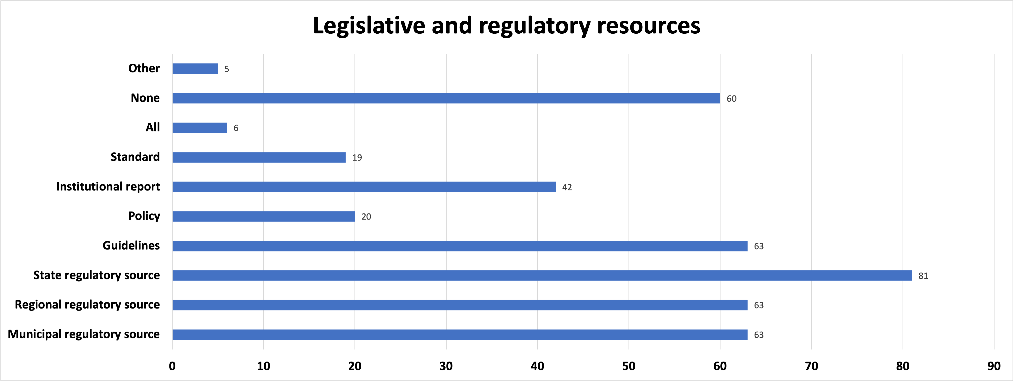
In this graph («Legislative and regulatory resources») there is a large number of "None”. Some answers in "Other” indicated the “European regulatory source”. In the graph we see also a predominance of «State
regulatory source» and a minority of «Standard».
23rd International Conference on Grey Literature - Digital Transformation of Grey Literature: Exploring Next Generation Grey

Slide 10
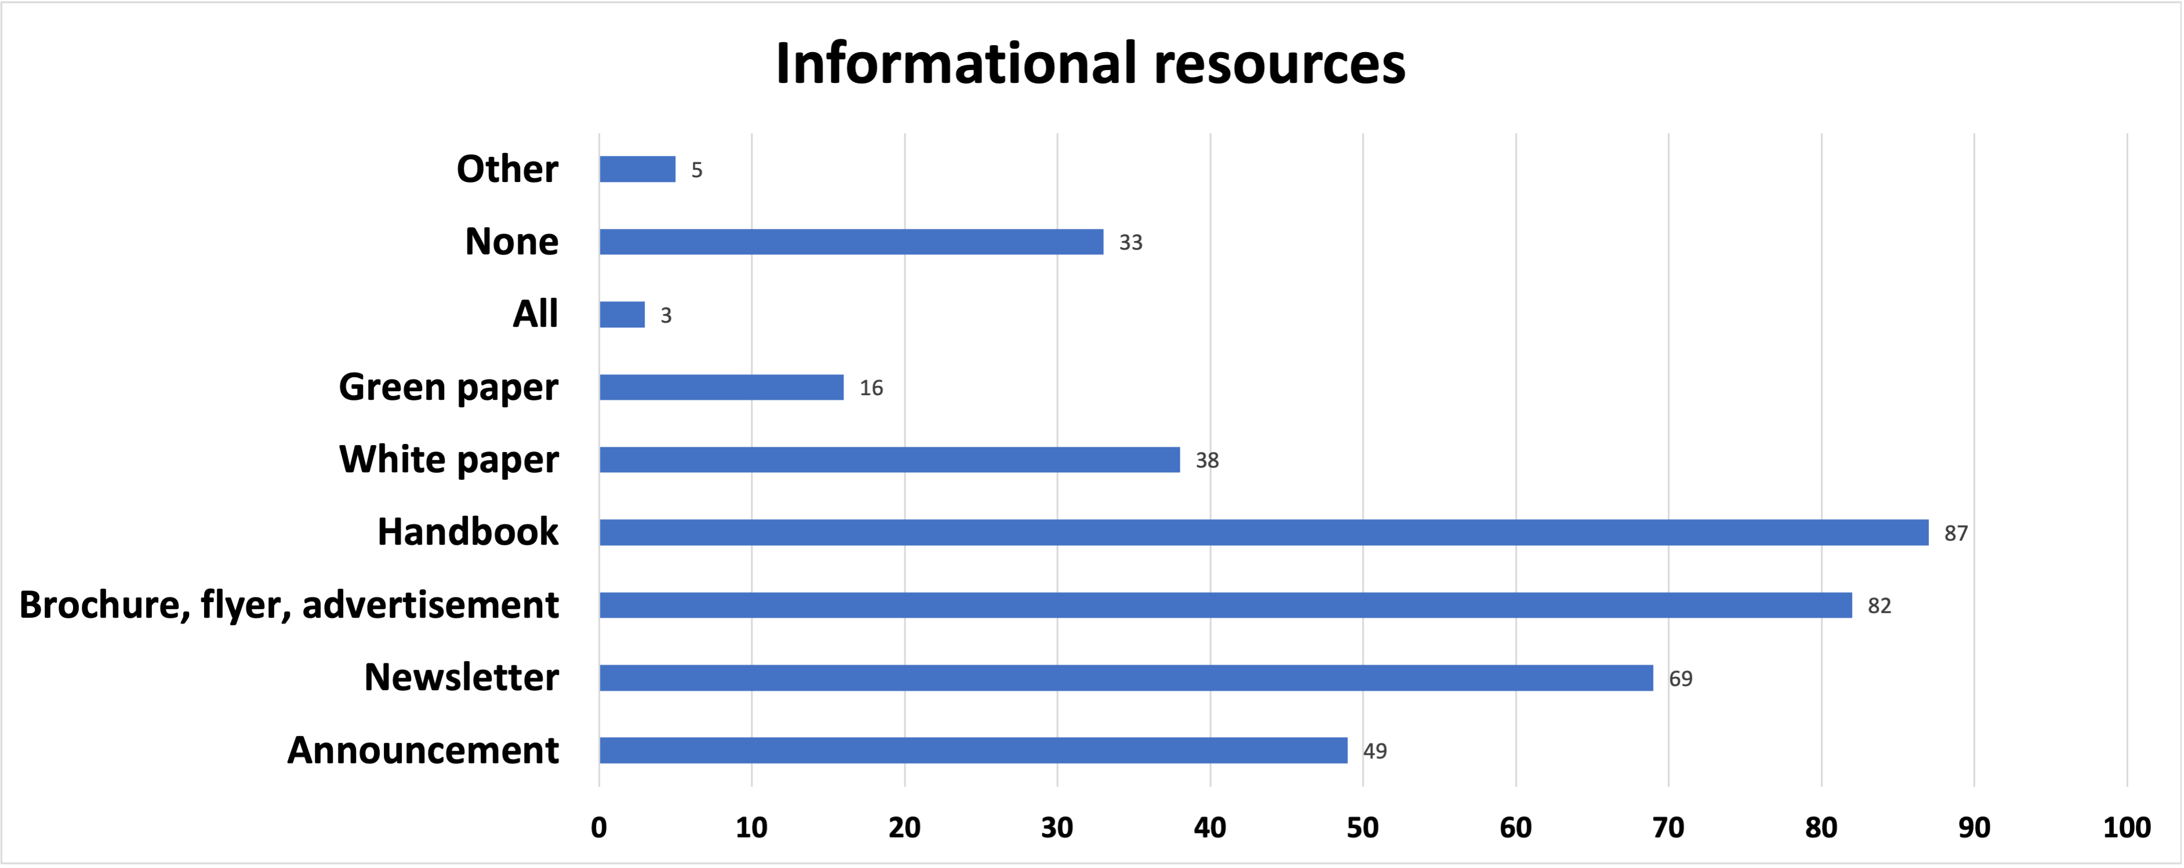
In the set «Informational resources» some respondents specified “websites” in the selection of “Other”. We can also see a predominance of «Handbook» and a minority of «green paper».
23rd International Conference on Grey Literature - Digital Transformation of Grey Literature: Exploring Next Generation Grey

Slide 11
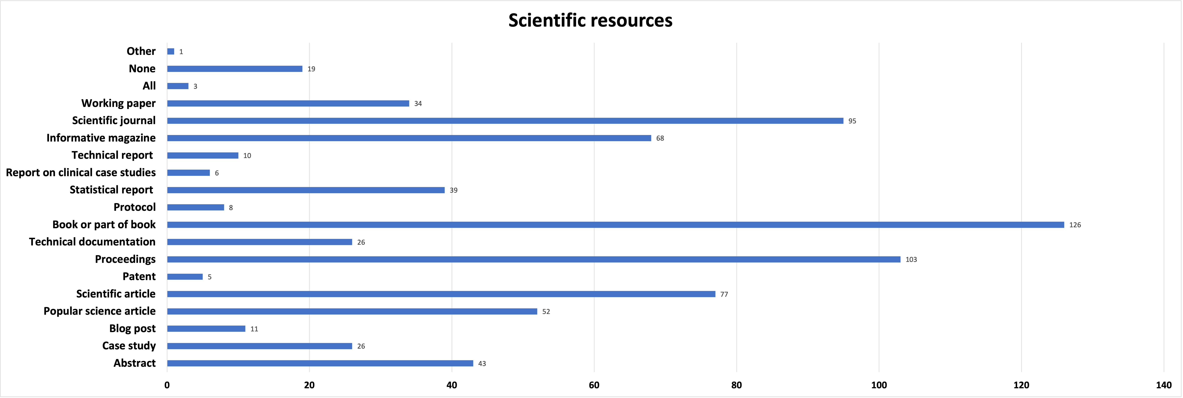
In the «Scientific resources» graph we can see a predominance of «book or part of book» and a minority of «patent». It may be due for two reasons:
if you publish you cannot make a patent; 2) the difficulty to obtain a patent.
One answer that in "Other» states that “the library
possesses All types of materials but not all is catalogued.
23rd International Conference on Grey Literature - Digital Transformation of Grey Literature: Exploring Next Generation Grey

Slide 12
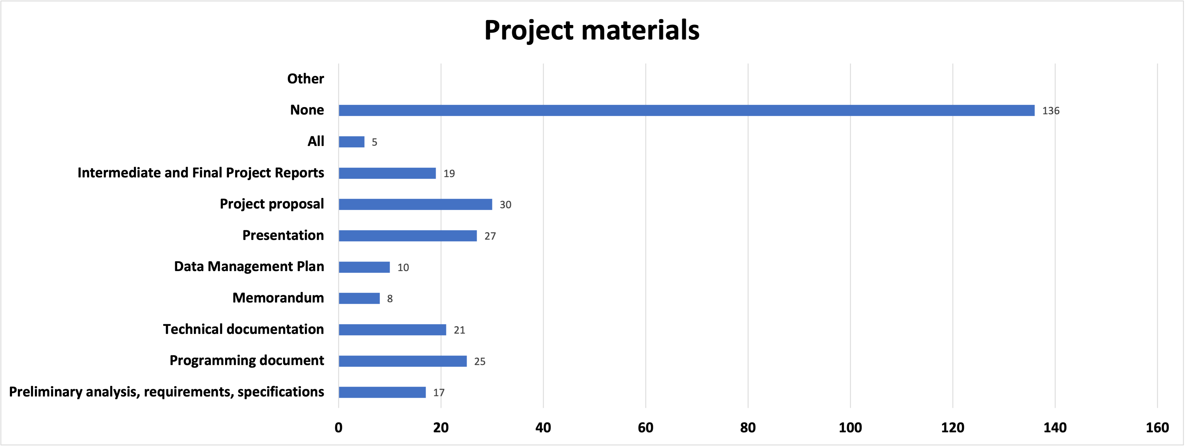
In the «Project materials» graph there is a predominance of «None» and no answers in «Other». Maybe all the categories were listed. We can see a predominance of «project proposal» and a minority of «Data Management Plan». Indeed, not all the projects presented are then funded.
Moreover, the mandatory request of a Data Management
Plan by many funding agencies is very recent.
23rd International Conference on Grey Literature - Digital Transformation of Grey Literature: Exploring Next Generation Grey

Slide 13
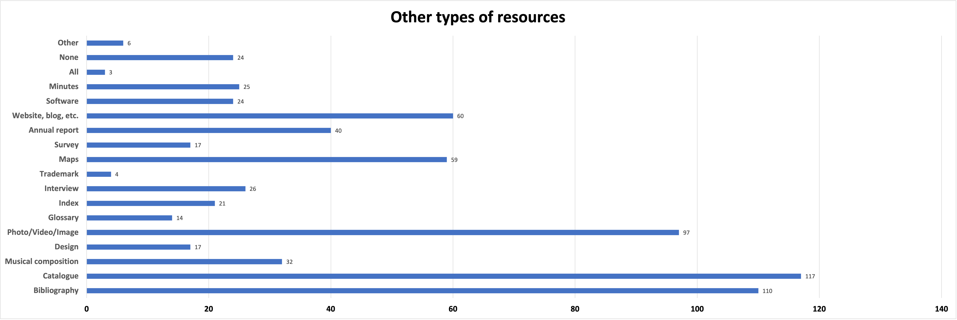
In the «Other types of resources» some answers in «Other» indicated a historical archive; we can see a predominance of «Catalogue» in the global answers and a minority of
«Trademark». That is logical for two reasons: It is strange a library without a
Catalogue. Trademark is not libraries main topic.
23rd International Conference on Grey Literature - Digital Transformation of Grey Literature: Exploring Next Generation Grey

Slide 14
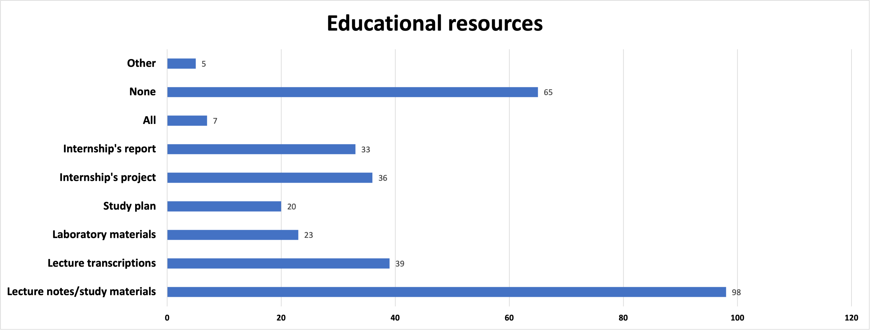
In the «Educational resources» graph a significant number of respondents indicated
«None». It may be due to the fact that the survey was not addressed to school or
academic libraries only. Some answers in «Other» indicated a historical legal –
economic material. The predominance is «Lecture notes/
study materials», while only a few selected «Study plan» or «All».
23rd International Conference on Grey Literature - Digital Transformation of Grey Literature: Exploring Next Generation Grey

Slide 15
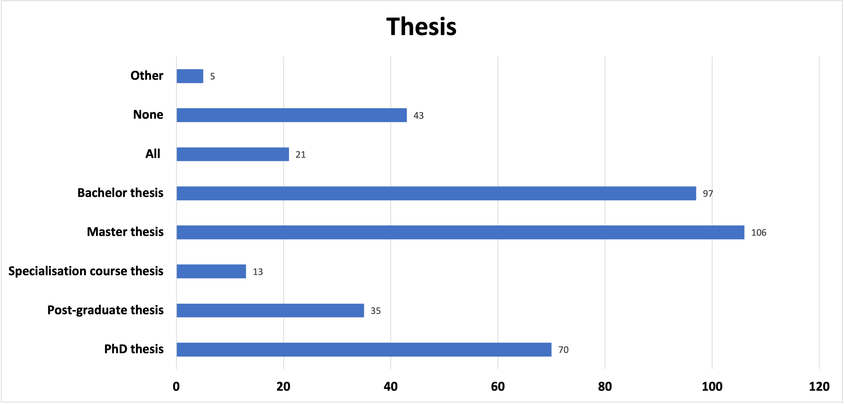
In the graph referred to the «Thesis», we can see a predominance of «Master Thesis»
followed by «Bachelor Thesis» and few «Specialisation course Thesis». Please note
that in Italy «Master Thesis» is referred to a highly specialized course on a specific
topic. In «Other» someone indicated that the
management of thesis is not the mission of the library;
they manage the few thesis that are researchers’ donations.
23rd International Conference on Grey Literature - Digital Transformation of Grey Literature: Exploring Next Generation Grey

Slide 16
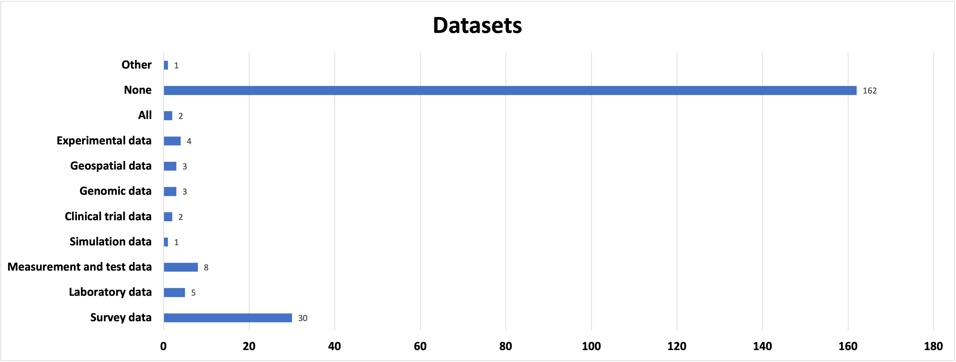
In the «Datasets» graph there is a predominance of "None”, followed by «Survey data».
Only a few respondents selected «Simulation data», probably due to the specificity
of this particular type of data. One answer in "Other” specified that materials
are stored in the Historical Archive.
23rd International Conference on Grey Literature - Digital Transformation of Grey Literature: Exploring Next Generation Grey

Slide 17
To better understand
people engagement in GL,
we analysed some comments
in the section related to
the interest in GL
23rd International Conference on Grey Literature - Digital Transformation of Grey Literature: Exploring Next Generation Grey

Slide 18
Some comments stated that the management of GL is not a priority for the institution, while others underline its importance and the interest in the topic.
Other comments report that GL is managed at every level, while some advice for more public knowledge and awareness, also through the use of repositories.
Therefore, we identify a discordant trend.
GL is not very well-known.
Nevertheless, it may be interesting to know more on that regard.
23rd International Conference on Grey Literature - Digital Transformation of Grey Literature: Exploring Next Generation Grey

Slide 19
CONCLUSIONS:
- Italian Libraries do not consider GL as a topic of primary interest.
- GL is managed.
- Need for more education on GL.
- Dedicated projects could be a possible solution to increase the interest on GL.
23rd International Conference on Grey Literature - Digital Transformation of Grey Literature: Exploring Next Generation Grey

Slide 20

Thank you
23rd International Conference on Grey Literature - Digital Transformation of Grey Literature: Exploring Next Generation Grey

