Slide 1
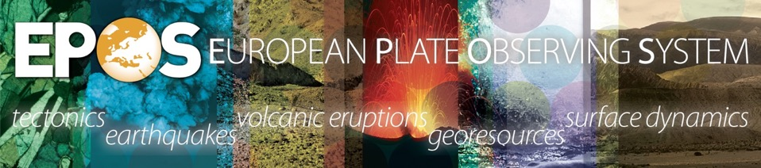
Sharing scientific data and products
in solid Earth sciences:
the EPOS (European Plate Observing System) research infrastructure experience
1 – Open Science & Access Rules
Massimo Cocco
EPOS ERIC Executive Director
www.epos-eu.org
massimo.cocco@ingv.it
massimo.cocco@epos-eric.eu

Slide 2







Solid Earth Science
Different communities involved
Multidisciplinary data & services
Community building required
Services to society operational
Geo-Hazards
Geo-Resources
Anthropogenic hazards
Notes:
DESCRIBE SOLID EARTH, SPECIFYING THAT:
WE STUDY THE WHOLE SOLID COMPONENT OF OUR PLANET (FROM THE INNER CORE TO THE SURFACE)
WE STUDY PROCESSESS EVOLVING IN VERY DIFFERENT TIME SCALES (from μιχρο−seconds to thousands years)
- WE STUDY PROCESSESS EVOLVING IN VERY DIFFERENT SPATIAL SCALES (from ΝΑΝΟΜΕΤΕΡΣ ΤΟ ΤΗΟΥΣΑΝΔΣ ΚΜ)

Slide 3
Solid Earth Science
Earth scientists have a long lasting tradition in data acquisition, collection, quality-control and standardization
They have skills and experiences in feeding and implementing metadata and services for qualification, storage and accessibility
Research infrastructures represent the facilities and resources to strengthen data management and interoperability through e-science innovation
Notes:
DESCRIBE SOLID EARTH, SPECIFYING THAT:
WE STUDY THE WHOLE SOLID COMPONENT OF OUR PLANET (FROM THE INNER CORE TO THE SURFACE)
WE STUDY PROCESSESS EVOLVING IN VERY DIFFERENT TIME SCALES (from μιχρο−seconds to thousands years)
- WE STUDY PROCESSESS EVOLVING IN VERY DIFFERENT SPATIAL SCALES (from ΝΑΝΟΜΕΤΕΡΣ ΤΟ ΤΗΟΥΣΑΝΔΣ ΚΜ)

Slide 4

Open Science
Open Data
Principles:
Open Access to Literature from Funded Research
Data from Funded Research in the Public Domain
Access to Research Tools from Funded Research
Invest in Open Research & Cyber infrastructures
Principles:
Open data is data that anyone can access, use and share
Open data becomes usable when made available in a common, machine-readable format
Open data must be licensed. Its license must permit people to use the data in any way they want (…)

Slide 5
Why does this matter?
Quality
Assessment
Deposit &
Licence
Assemble
Methods, Materials
Simulate
Observe
Experiment
Publishing Services
Research Infrastructure
Services
Analyse
Results
Disseminate
Share
Results
Manage
Results
Track and Credit
Moving between different environments
Recreating / accessing common environments
Fragmented, multivarious and complicated …
Science 2.0 Repositories: Time for a Change in Scholarly Communication Assante, Candela, Castelli, Manghi, Pagano, D-Lib 2015
Notes:
Needs to be seamless, faster and

Slide 6

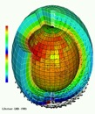



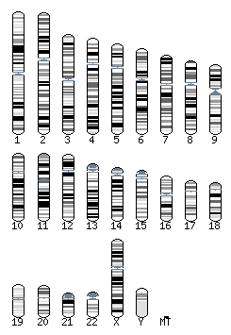






Access to data: a global challenge
www.epos-eu.org
Grand Challenges facing the world demand open access to data making them FAIR:
  Findable
  Accessible (Understandable)
  Interoperable
  Re-usable (Reproducible)
More value from reuse of data
More and more researchers are seeing the value of sharing data
Many countries developing open research data policies
Central Role of Research Infrastructures

Slide 7
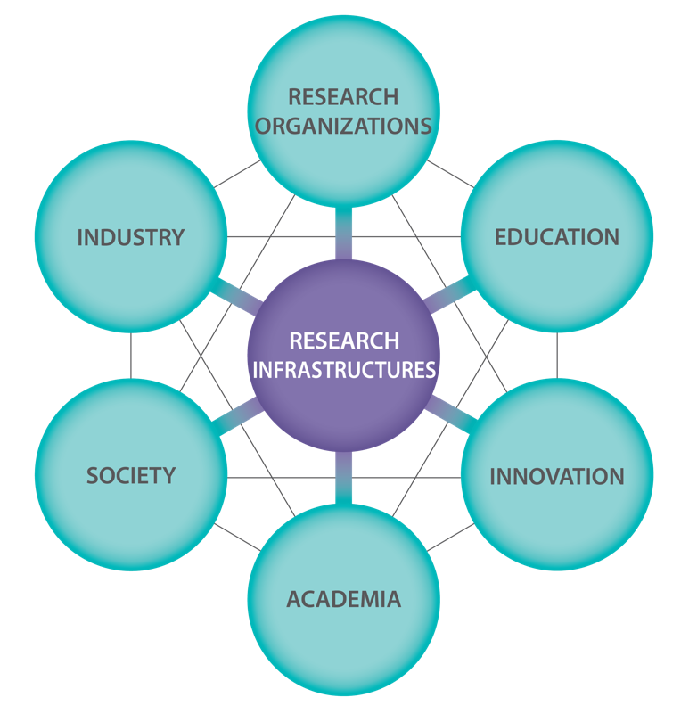
Research Infrastructures: EPOS
provide virtual access to data and physical access to facilities
allow communication with different stakeholders
tackle sustainability challenge from a technical, legal, governance and financial point of view
strengthen data management and interoperability through e-science innovation
EPOS

Slide 8
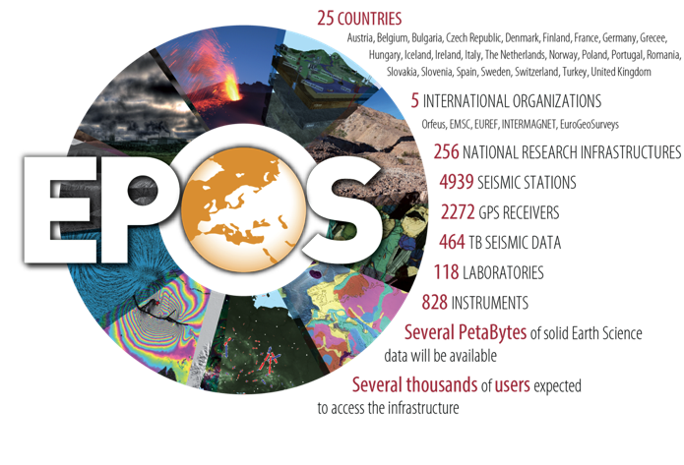
EPOS is a long-term plan for the integration
of research infrastructures for solid Earth Science in Europe
EPOS integrates the
existing (and future)
advanced European
facilities and
infrastructures into
a single, distributed,
sustainable
research infrastructure
taking full advantage of new e-science opportunities

Slide 9
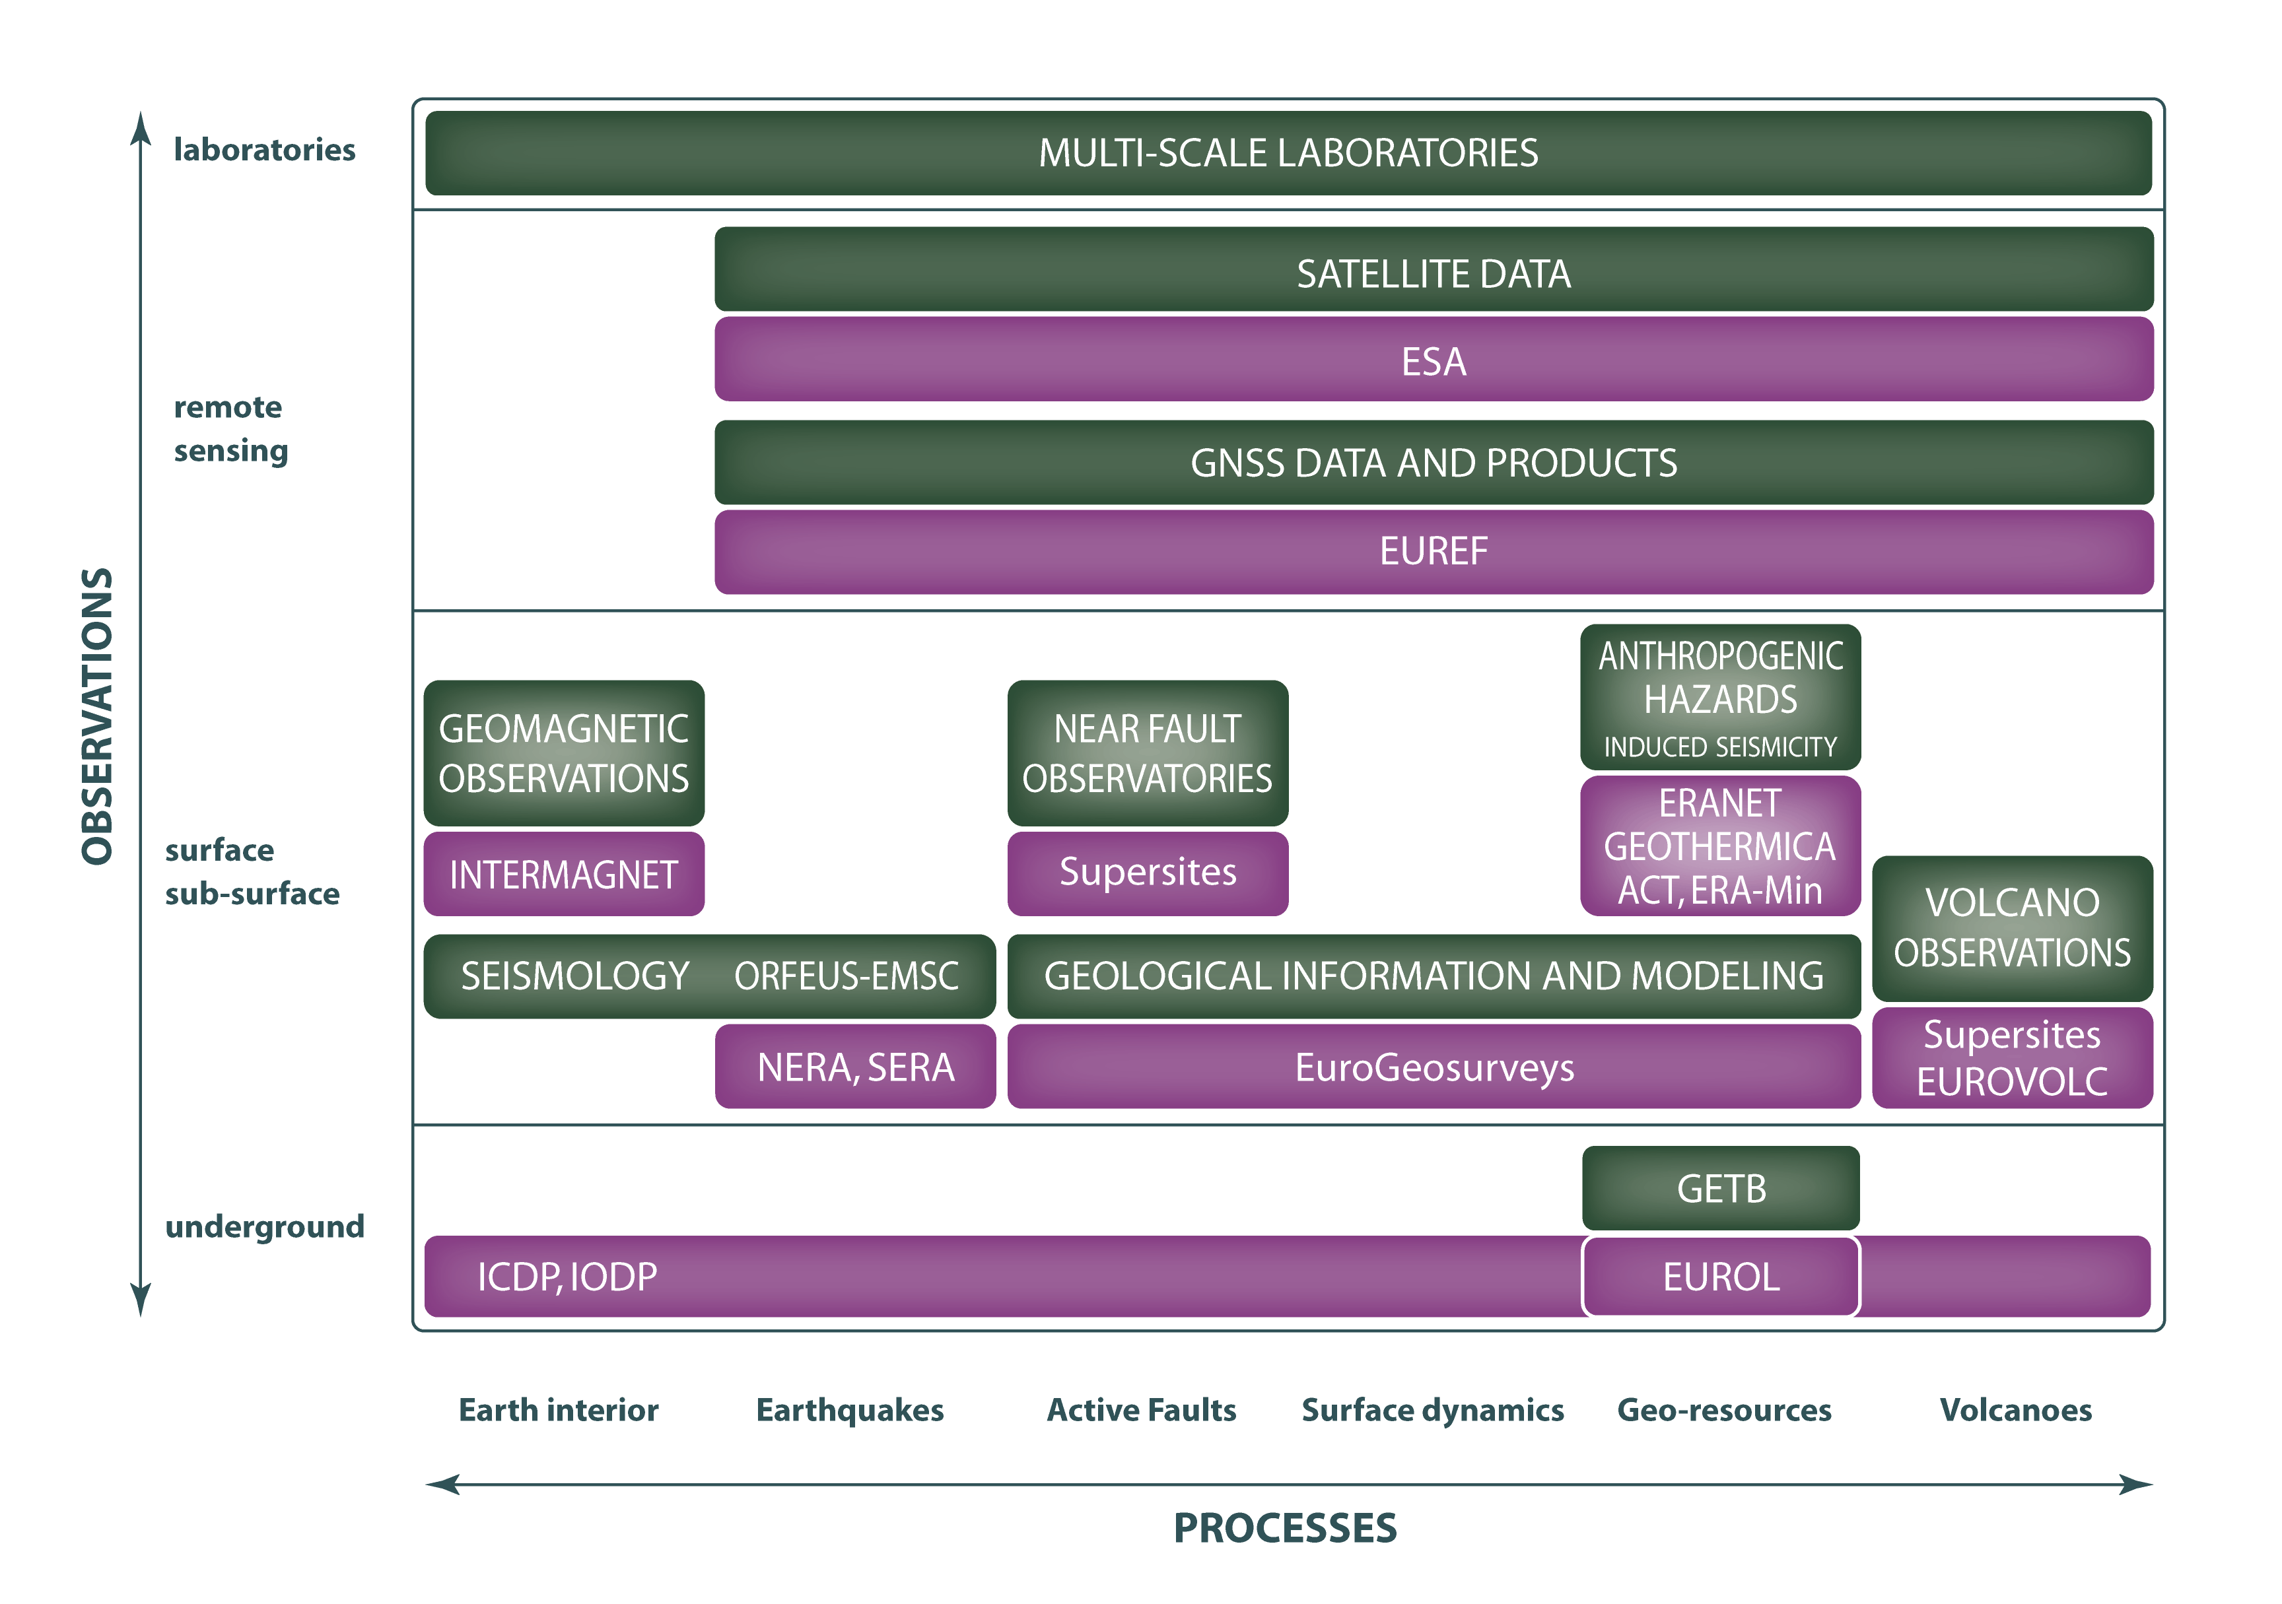
EPOS Multidisciplinary Scientific Framework

Slide 10
The EPOS experience & practice
Data Generation
Acquisition
Quality control
Service Operation
Qualification (PID, DOI, rich metadata)
Storage
Virtual Research Env.
Visualization
Processing
Metadata
Standardization
Accessibility
Interoperability
Computation
Integration
For Distributed pan-European RI
Notes:
Making data FAIR requires time and resources which are provided by the scientific communities involved in data and service provision through RIs
RIs also operate Services (storage, accessibility, workflows, processing, visualization) that are implemented not solely to access data, but also to integrate data as well as to generate new data products through IT resources
Metadata standardization requires skills, resources and time and effective engagement of the scientific communities in charge of maintaining the data and metadata
Data interoperability requires effective IT solutions and resources (human and technological) to make data & metadata conceptualized
Creating FAIR+R data involves accountability of data providers and data provenance
Making data Re-usable has legal (licensing, policies), financial (costs of storage), governance (maintaining services and access) and technical implications

Slide 11
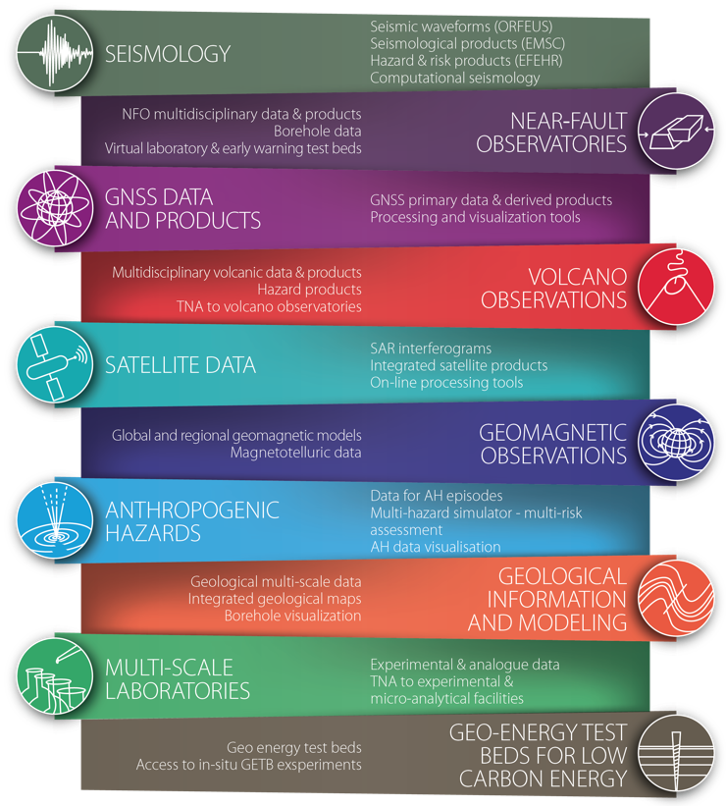
Data Generation
National , Regional RIs
Engagement of Data Providers
Community Level Integration (TCS)
Federation at community level

Slide 12
The EPOS experience & practice
Data Generation
Acquisition
Quality control
Service Operation
Qualification (PID, DOI, rich metadata)
Storage
Virtual Research Env.
Visualization
Processing
Metadata
Standardization
Accessibility
Interoperability
Computation
Integration

Slide 13
Data Timeline and Services
Acquisition
Transmission
Satellites, phones lines, radio links, …
Collection
Data centers,
Real Time analyses,
Elaboration
Time series
Measurements
Qualification
Digital objects (data+ Metadata, Persistent Identifiers)
Community Data infrastruct., Big Data centers
Accessibility
Discovery, Access, Download,
Storage
Experiments
Data products generation
HPC, HTC, Data-intensive applications
Operational Services (AAI, …)
SERVICES
Acquisition
Transmission
Qualification
Storage
Accessibility
Collection
Data acquisition, validation & standardization
Data collection & preservation (PID, DOI)
Accessibility, integration, computation

Slide 14
Data & service provision
EPOS RIs produce a wealth of standardized, quality-controlled data for science and society.
Standardization and quality control implies engagement of the scientific communities to harmonize data and metadata.
Data heterogeneity: raw data, data products, software and services.
Monitoring networks and observing systems also serve for environmental surveillance, alert, and geo-hazard assessment
Data collected for geo-resources exploitation and anthropogenic hazard
Awareness of Data Value = Utility + Warranty
  Utility: data is useful, harmonized, standardized ……
  Warranty: data is accessible and traceable

Slide 15
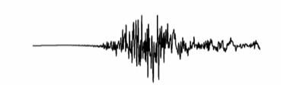
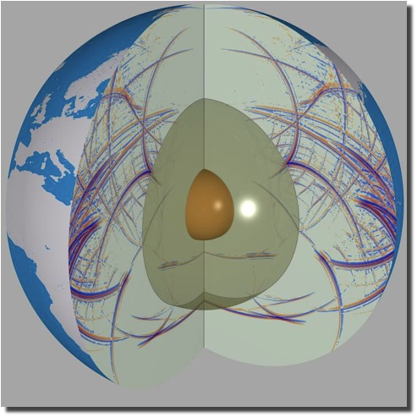
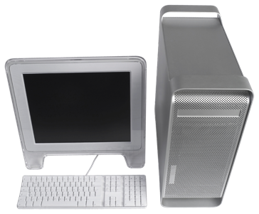
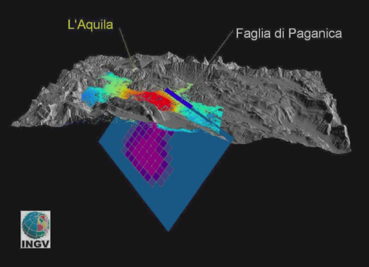
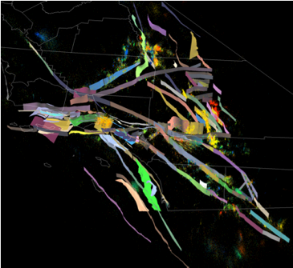
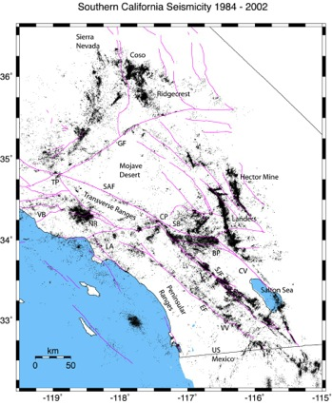
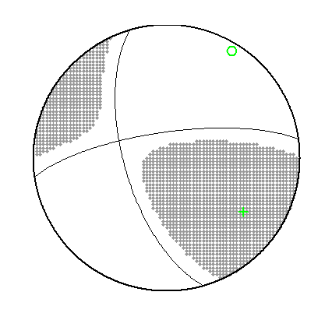
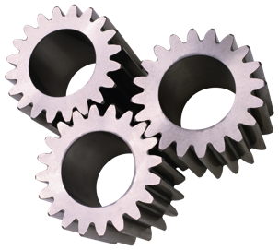
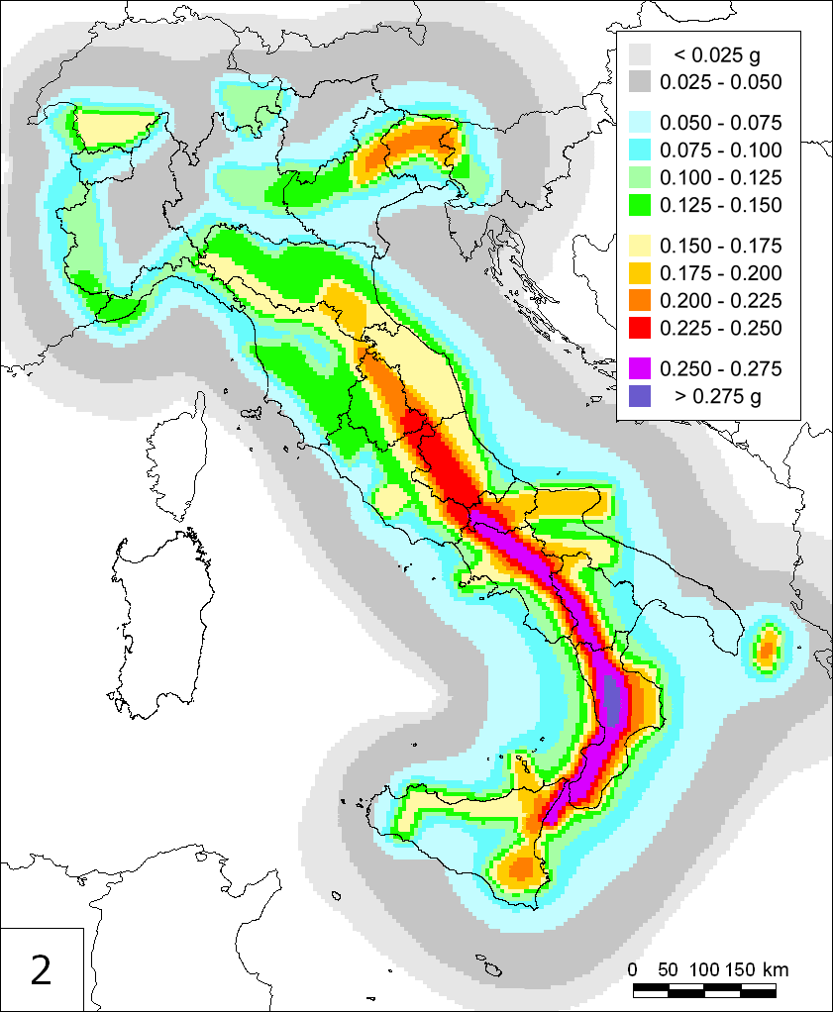
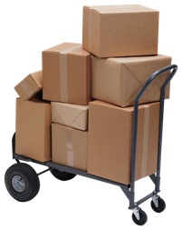
Access to Data Products (Taxonomy)
Level 0: raw data, or basic data
Level 1: data products coming from nearly automated procedures
Level 2: data products resulting by scientists’ investigations
Level 3: integrated data products coming from complex analyses or community shared products
Level 4. Software, IT tools
seismograms
Earthquake
locations
Interferograms
Seismic hazard
map
Notes:
PROGRESS IN SOLID EARTH SCIENCE RELIES ON INTEGRATING DATA AND DATA PRODUCTS.
THIS ACTION IMPLIES THE ENGAGEMENT OF DIFFERENT STAKEHOLDERS WITHIN S.E.: DATA PROVIDERS AND USERS

Slide 16
EPOS Data, Access, and IPR policy
Guiding principles: – open access
– licensing
– no charges
Protect EPOS legally
Unrestricted use & access
Trace EPOS use & users
Balance: Legal risk : Openness : Traceability
IPR
Terms & Conditions
Restrictions
Licensing
Open Access
deposit terms
Open Access license
Data & Service
Providers
EPOS
Data & Service
Users
Categorization
as needed for legal aspects
Data & Data Products
Level 0,1, 2, 3
Tools & Software
Open : Restricted : Embargoed
mix and match as required
Anonymous : Registered : Authorized
Users

Slide 17
A Major Task of RIs
Data Processing
Capture
Resources
Transfer
Tools
Data Collection /Creation
Data Collection /Creation
Data Visualisation
Data Life
Cycle
Tools
Interoperability
Resources
Integration
Archiving/ Curation
Data Analysis &
Products
Archiving/ Curation
Data Policy
Tools
Publication/ Dissemination
Data Management Plan
Resources

Slide 18
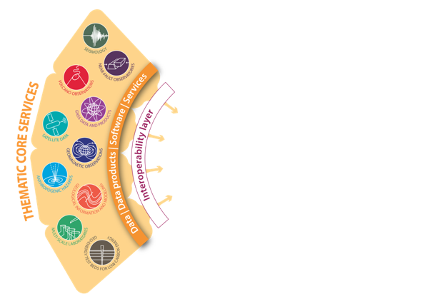
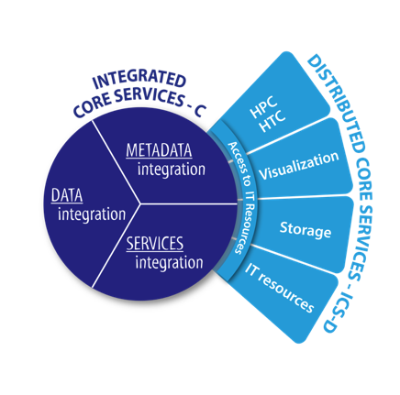
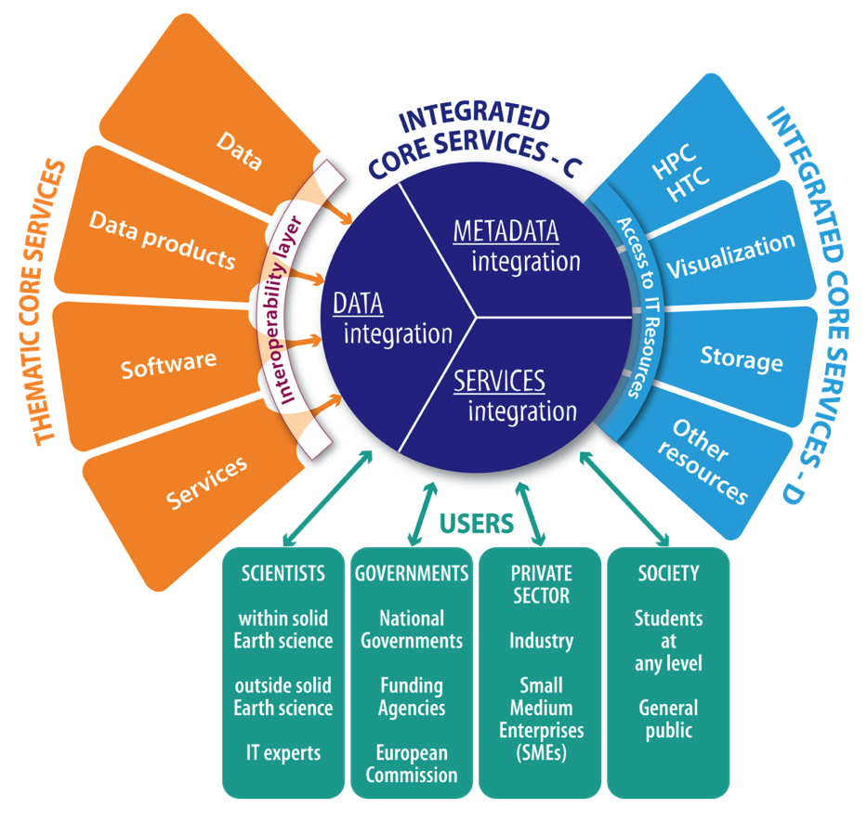
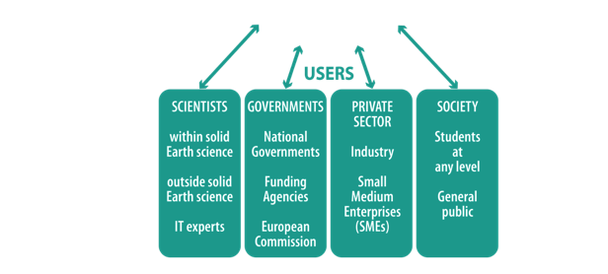
EPOS Architecture
The EPOS data & service provision to diverse category of stakeholders
SCIENTISTS
Data providers
Data users within the SE community
Data users outside the SE community
IT experts
GOVERNMENTS
National governments
Funding agencies
European Commission
PRIVATE SECTOR
Industry
Small Medium Enterprises
SOCIETY
Students at any level
General public

Slide 19
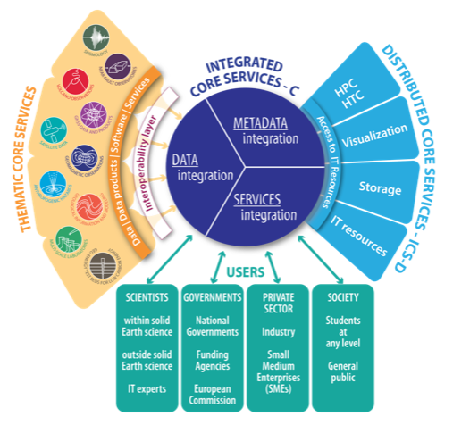
EPOS Mission
According to its vision, the EPOS mission is to create a single, distributed and sustainable, infrastructure that integrates the diverse and advanced European National RIs for solid Earth science under a common framework to provide open access to data and products for diverse user categories
Data from observing systems
National Nodes
Site monitoring

Slide 20



an example from seismology
Real Time Services:
EPOS TCS:
community driven and governed services
Waveform Services
Waveform selection & access
Waveform metrics & Station Information
Strong Motion parameters
OBS data integration
Mobile Pool coordination & integration
Waveform modeling
Seismological Products
Earthquake Parameter Information
Macroseismic & Historical Event data
Seismological Products Platform
- rupture models / SiteCharTool / MT
- EventID / F-E-Region / …
Hazard and Risk Services
Seismic Hazard Models
Seismogenic Faults
Ground Shaking Models
Geotechnical Engineering Information
Strong Motion records in buildings
Earthquake Engineering & Risk Services

Slide 21

From data to products
Access to
Seismologists
Seismic waveforms from NRIs
Quality controlled and integrated in ORFEUS EIDA
Integrated new metadata in European Strong Motion database (ESM)
Accessible to engineers, geophysicists, professionals, global organizations
Used to calibrate Ground Motions Predictive Equations GMPE
Used to Seismic Hazard Assessment for policy makers and industry
Access to other
Stakeholders:
Private Sector
Civil Protection
Integrated at
Global Level
FDSN -> GEO
New data
& Services in
TCS Seismology
(Orfeus)
New products
for Hazard
Assessment
(scientists)
VA from other
Stakeholders
(scientists)

Slide 22
Data and Service provision to different stakeholders:
Ethics Issues
OPEN SCIENCE COMMONS
Scientists
open access
ETHICS ISSUES
risk communication
exploitation
RISK MITIGATION
Society
PRIVATE SECTOR

Slide 23
Summary – Points for Discussion
Solid Earth Science is composed of different communities having a different tradition and awareness on data management and open science with peaks and gaps
In solid Earth sciences (EPOS), data sharing has enormous potential. A new typology of scientists targeting multidisciplinary problems asks to have open access to data and scientific products
The long-lasting RIs tradition in data & metadata standardization and quality control should be preserved as a necessary condition to make data FAIR+R.
Challenges to tackle FAIRness in terms of available resources and solutions:
  Traceability and persistent identifiers (accountability of data providers)
  Access procedures, ideally by automated means, to data & services
  Data provenance and traceability and link to publications
To achieve the best results, continuous orchestration between scientific communities and ITs (e.g., AAAI, PID) is needed
Interactions with industry in Earth sciences require effective strategies and particular attention (ethic issues, use and re-use of scientific data)

Slide 24
The EPOS chain: high gain/high-but manageable risk
Access
Integrated use of data
Understanding
Processing and modelling
Data massive applications
Discovery
Trust
Ideas & serendipity
Authoritative Services
Training and education
Facilities
Industry & SMEs
Society
Use & Re-use of Data

Slide 25

The Data Generation Universe
Observing Systems
Monitoring Networks
Experimental Facilities
Observatories
Researchers
Scientific Knowledge

Slide 26
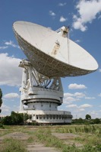

The Data Generation Universe
Research Infrastructures (RIs) sample a limited portion of the Data Generation Universe, while ensuring:
Research Infrastructures
Quality Controlled data
Standardized Data & Metadata
Metadata Curation & Integration
Data Curation and Integration
Services curation and integration
Access to data and products
Visualization of integrated data
Access to multidisciplinary data
Generation of new scientific products
Data qualification
Service qualification
Long Tail of Science

Slide 27
Open Science & FAIR Data require Resources
Thank You
For your attention

Slide 28

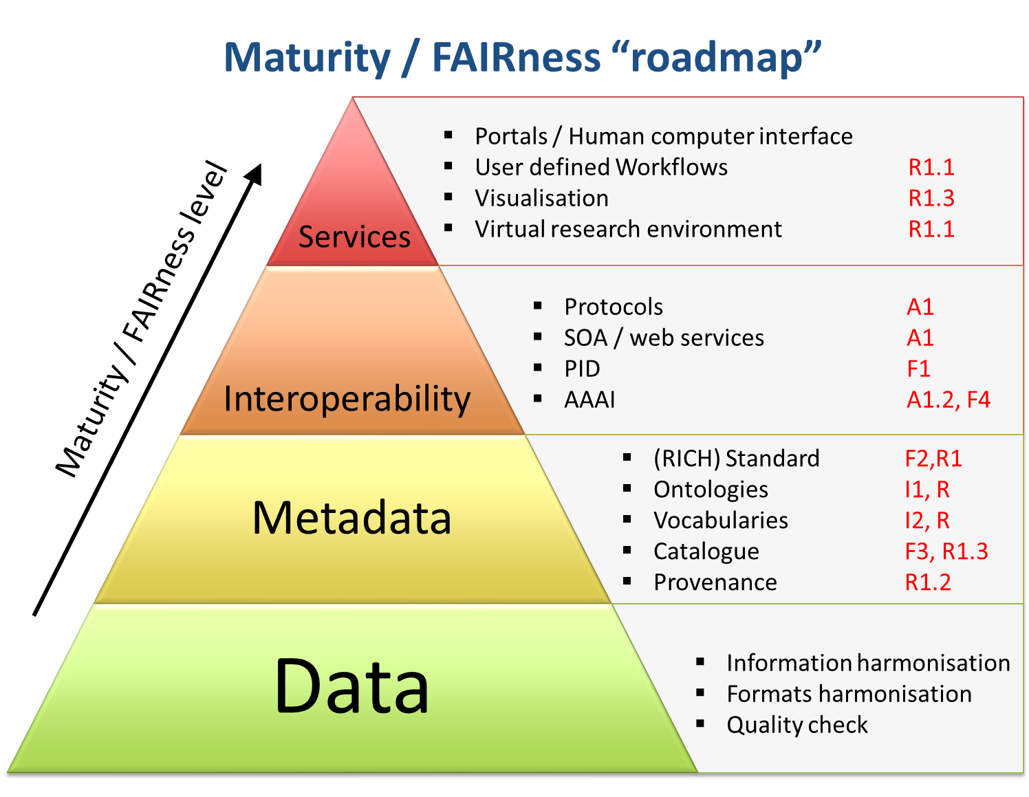

Service Operation
+
Reproducible
Daniele Bailo EPOS

