Slide 1



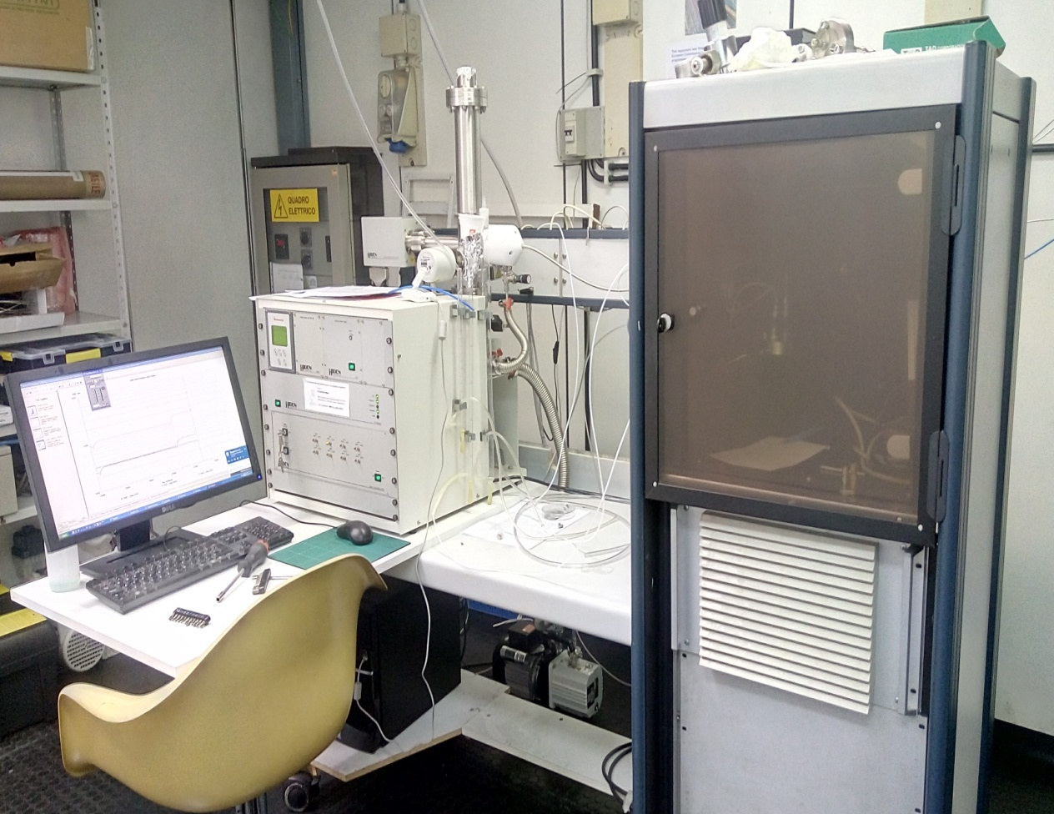


Pure versus mixed gas permeability of novel polymers of intrinsic microporosity
E. Esposito¹, R. Williams², I. Rose ², M. Lanč ³, A. Fuoco¹, M. Monteleone¹, M. Carta², N.B. McKeown², J.C. Jansen¹
¹ Institute on Membrane Technology, ITM-CNR, Via P. Bucci 17/C, 87036 Rende (CS), Italy, e-mail: jc.jansen@itm.cnr.it
²School of Chemistry, University of Edinburgh, David Brewster Road, EH9 3FJ, UK
³ University of Chemistry and Technology, Prague, Czech Republic
Objective
Results and Discussion
The level of CO₂ in the atmosphere is rising due to a continuous consumption of fossil fuels for industrial and domestic use. This necessitates the development of new technologies to avoid a climate change, which would cause a risk for the life on our planet. Membrane separation processes are seen as one of the potential solutions to the problem, offering the advantage of cheap production and simplicity of operation compared to other separation techniques.
One of the most ambitious projects to reduce CO₂ emission is the capture of CO₂ from CO₂/N₂ mixtures, like in flue gas. In the present study, materials with high intrinsic microporosity (PIMs) are studied and their performance in terms of CO₂/N₂ separation is evaluated.
Pure gas measurements of homopolymers
The two homopolymers are highly permeable, close to the Robeson upper bound performance. The methanol treatment makes the membrane more permeable than the temperature treatment. The IR-579a homopolymer H2 is more permeable than the Methano-Pentacene (MPTB) homopolymer H1.
Pure gas measurements of copolymers
The three copolymers are in the highly permeable region, close to the homopolymers. The 80-20 % copolymer has generally a higher permeability than the 90-10% copolymer and than the homopolymer. The advantage of the copolymers is that they have a much better mechanical resistance than the homopolymer.
Schematic representation of CO₂/N₂ membrane separation from exhaust flue gas
Experimental
Materials
Two homopolymers (H1,H2) and a family of three novel PIM copolymers (C1-C3) are studied in this work. All polymers are sufficiently resistent to form robust self standing membranes.
H1 - Methano-Pentacene (MPTB)
H2 - IR-579a
PIM-Trip-TB
PIM-EA(Me)-TB
PIM-EA(H₂)-TB
90-10 25 ºC, After MeOH
80-20 25 ºC, After MeOH
C1 - Methano-Anthracene (MA) +EA (Me)-TB
C2 - Methano-Anthracene (MA) + EA(H₂)-TB
90-10 140 ºC, Vac 4 h
80-20 140 ºC, Vac 4 h
One of the reasons for the combination of high permeability and high selectivity of polymer IR-579a is the very high rigidity of the polymer chain, causing a much stronger size sieving behaviour than other polymers with comparable permeability.
C3- Methano-Anthracene (MA) + Trip-TB (H₂)
Gas permeability measurements
Single gas permeability measurements were carried out with the six gases : He, H₂, N₂, CO₂, CH₄, and O₂ for two different states of the membranes: after methanol treatment and after thermal conditioning.
During the permeation experiment, the pressure increase on the permeate side is recorded as a function of time. Three different stages of permeation can be recognized: penetration, transient and stationary stages. The permeability coefficient was calculated from the equation that describes the steady state permeation.
Mixed gas permeability measurements
The mixed gas measurements were carried out with a mixture of CO₂/N₂ at different pressures, following the concentration of each gas in the permeate as a function of time.
The permeability of the homopolymer IR-579a is independent of the transmembrane pressure and its high permeability is coupled with a high selectivity, making this polymer particularly interesting for the separation of flue gas mixtures.
In the mix gas setup the permeate composition is followed in line real time analysis, allowing the analysis of transient phenomena, for instance during a stepwise increase of the feed pressure or a change of the feed composition.
Conclusions
All homopolymer and copolymer membranes in the present work are sufficiently stable to allow gas permeability measurements, giving results close to the Robeson upper bound performance for pure gases.
The mixed gas separation performance of homopolymer H2 membrane is close to the ideal behaviour determined with the pure gases, confirming that there is no strong coupling effect.
The in-line real time analysis of the permeate composition offers the possibility to study the transient behaviour and to determine the diffusion coefficient of gas mixtures, for which a feasibility study is now in progress.
Acknowledgements: Part of the research leading to these results received funding from the European Union’s Seventh Framework Program (FP7/2007-2013) under grant agreement n° 608490, project M4CO2.
Notes:
1

