Slide 1
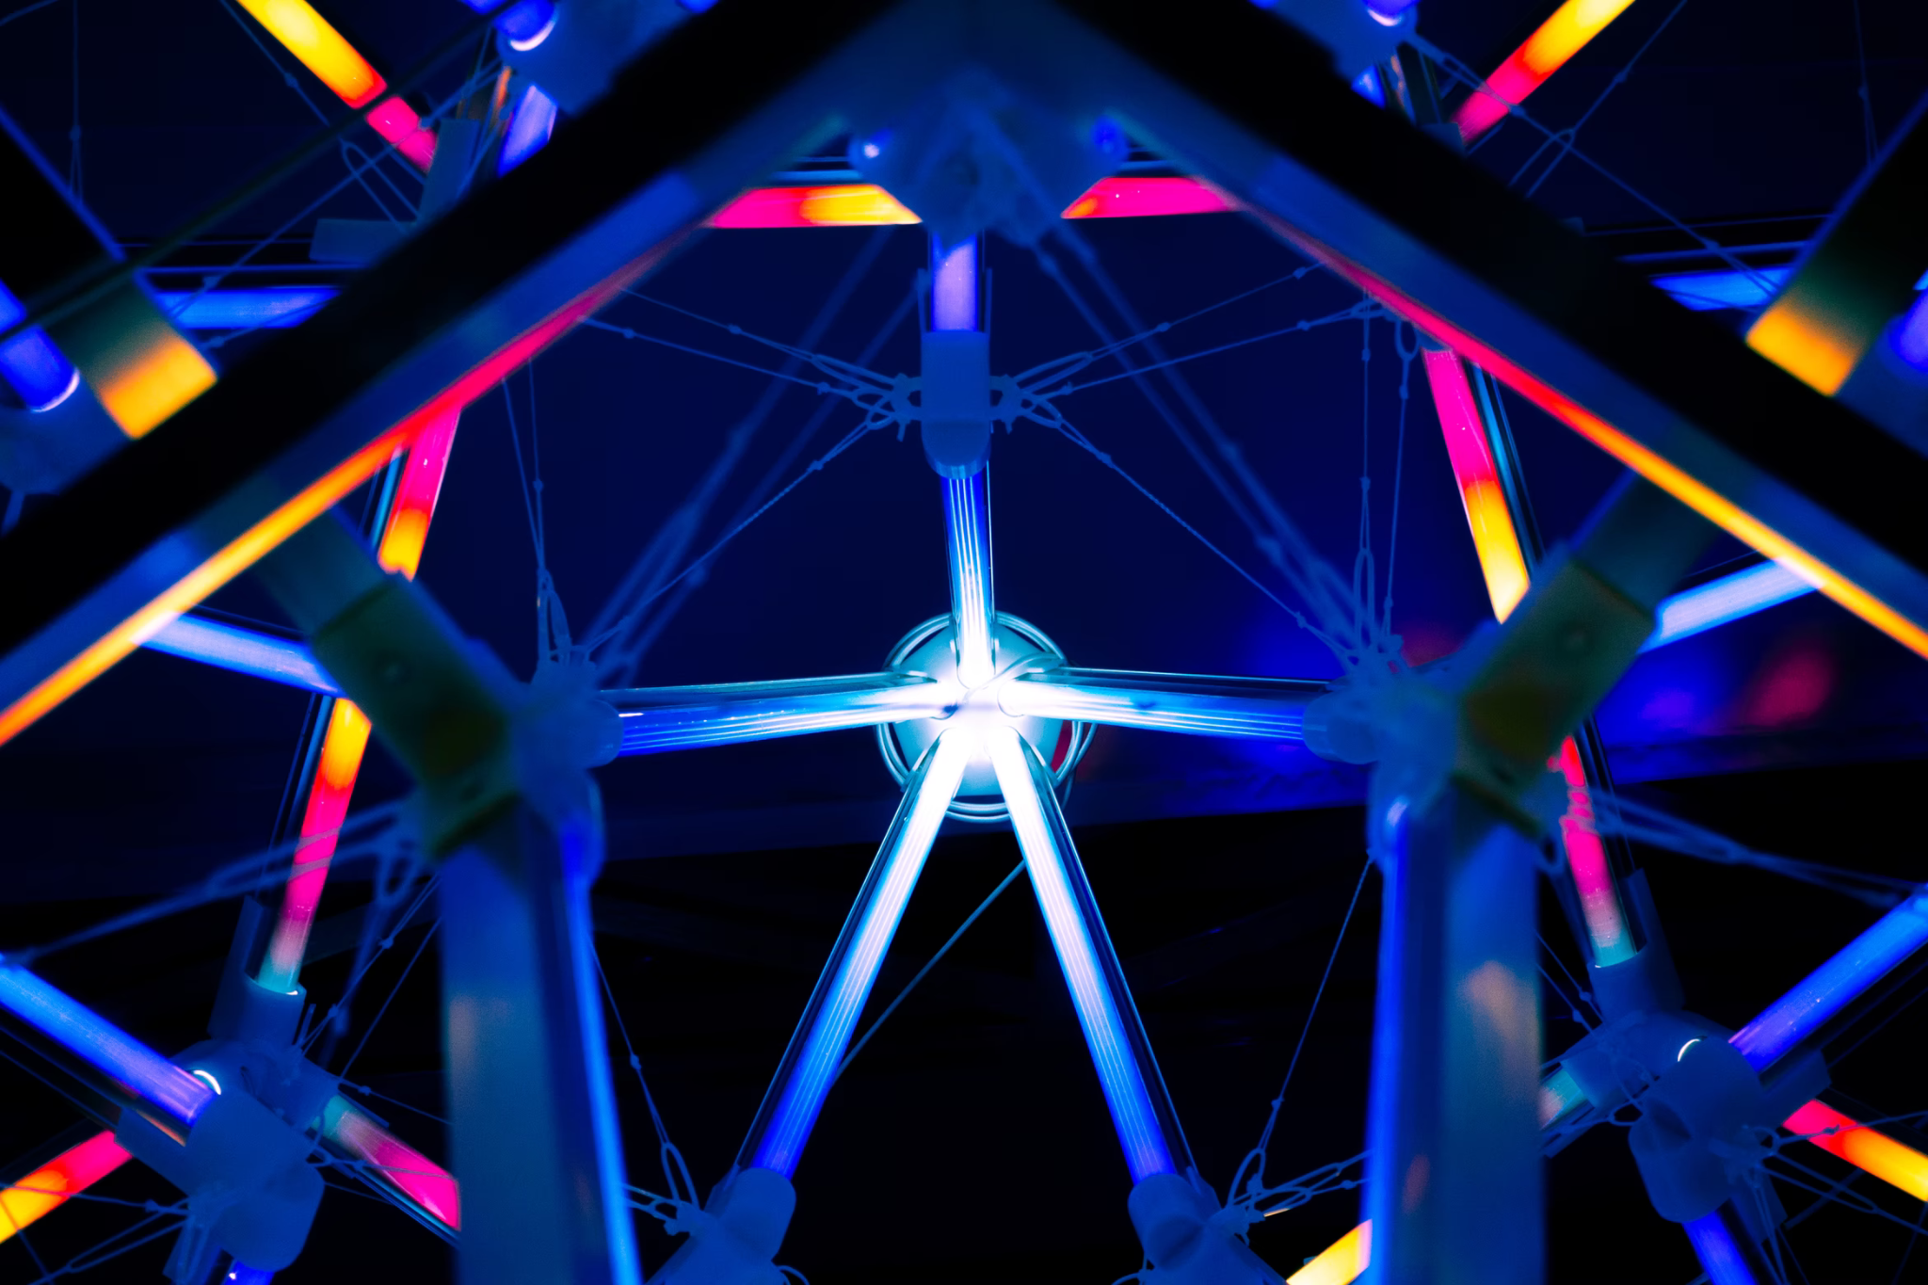


Open Science
in research projects
More better, Open Science
module 1.4
Gina Pavone 0000-0003-0087-2151
Emma Lazzeri 0000-0003-0506-046X
5 November 2021

Slide 2
Capacity building:
The ICDI Competence Centre
The Italian portal on Open Science

Slide 3

Italian Computing and Data Infrastructure - ICDI
A “ working table” created by representatives of some of the main Italian Research and Digital Infrastructures
It aims to promote synergies at national level in order to optimize the Italian participation to the current European challenges, including the European Open Science Cloud (EOSC), the European Data Infrastructure (EDI) and HPC (High Performance Computing)
MUR is an observer
In November 2020, ICDI received a mandate from MUR to represent Italy within the EOSC Association, of which ICDI is a founding member.
https://www.icdi.it/it/

Slide 4
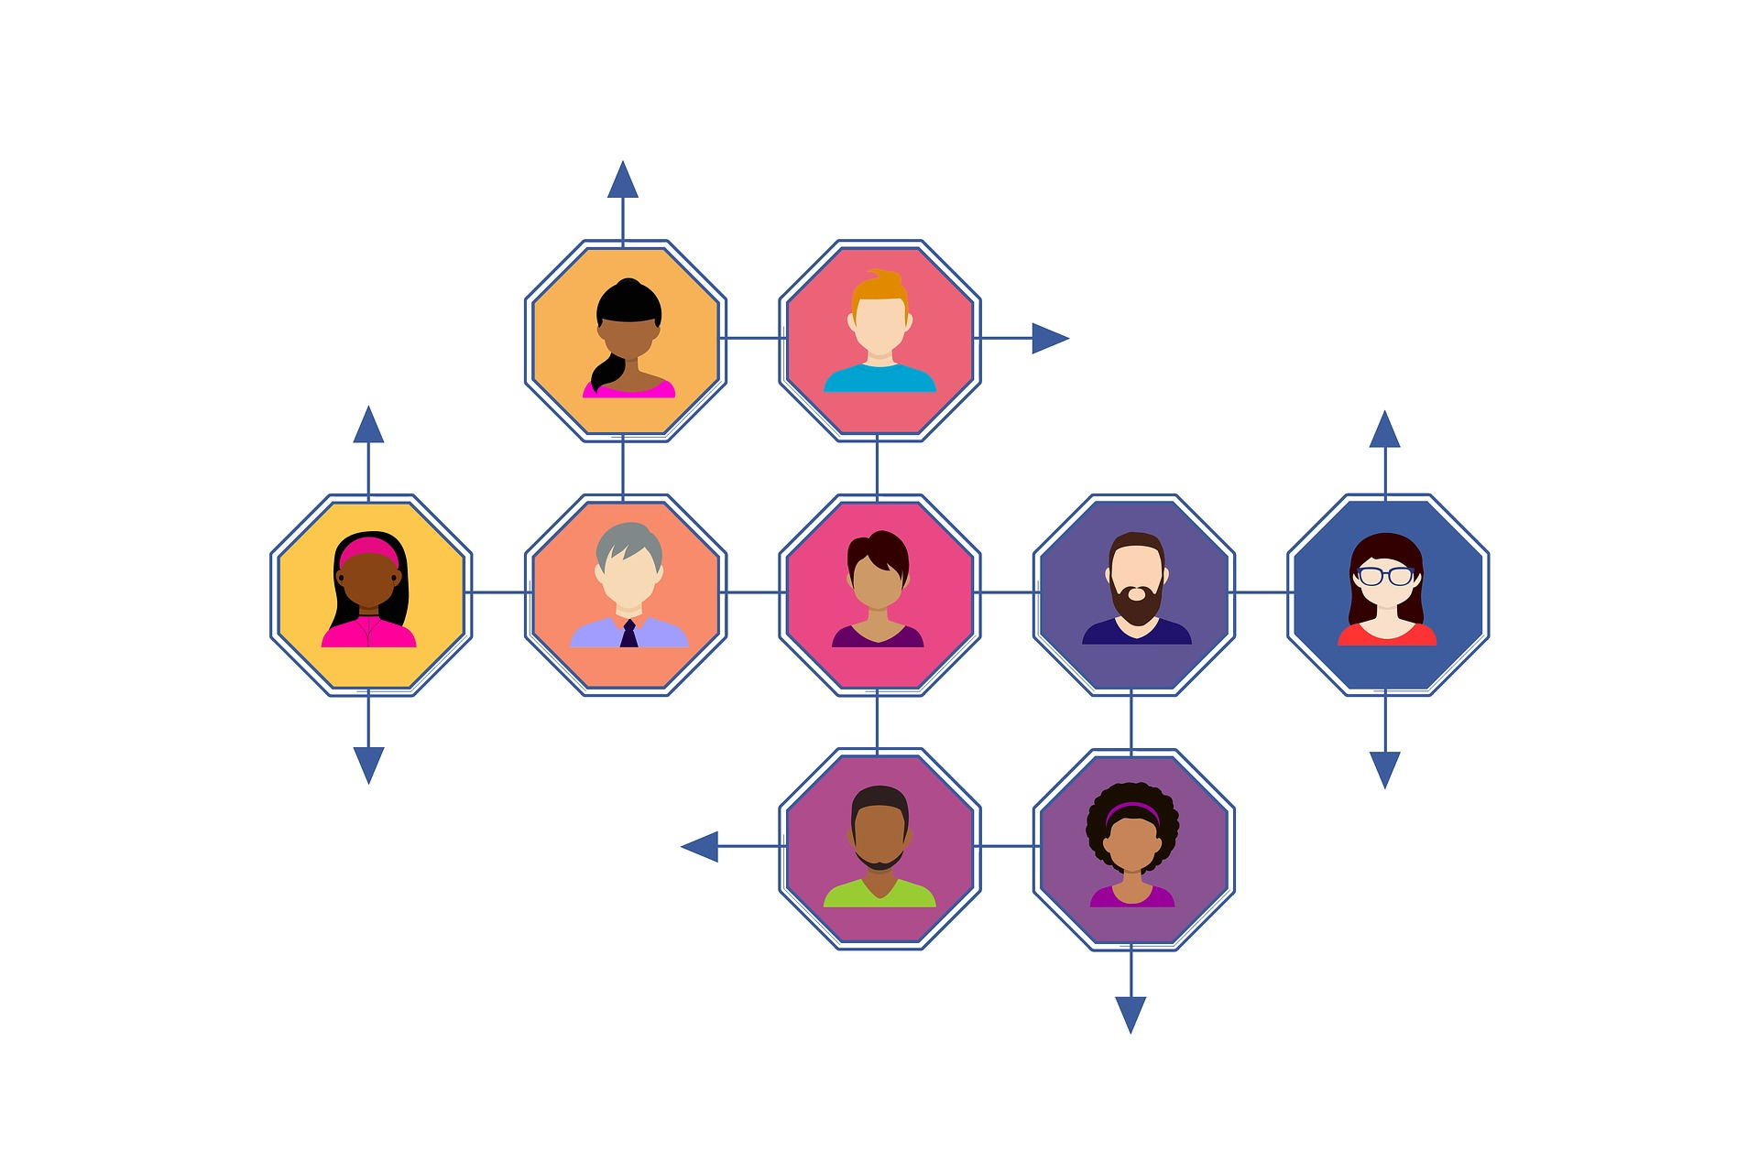
ICDI
Competence Centre
Nationwide support from Open Science, FAIR, and EOSC experts

Slide 5
More than 50 experts involved in the CC
Experts in different fields and affiliated with 23 different institutions

Slide 6
ICDI-CC
Mission
Create a network of experts, initiatives and Research Infrastructures with all the different competences needed to support the Italian community on Open Science, FAIR principles and on the Italian participation to the European Open Science Cloud (EOSC).

Slide 7
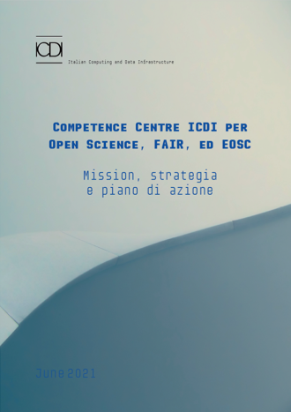
Mission, strategy and Action Plan
Published in June 2021
Italian Version: https://zenodo.org/record/5071055#.YYQScJ5Kgq3
English version: https://zenodo.org/record/5512638#.YYEIRJ5KhJU

Slide 8
CC as a single national reference point for:
training and support: providing support, consultancy and training activities on Open Science, FAIR principles and EOSC.
empowerment: fostering the integration of Open Science in the daily practice of the different stakeholders, through the acquisition of skills and the awareness of the positive effects.
professionalization: designing and promoting structured training and the introduction of the new professional figure of the data steward into research institutions.
good practices: promoting the development and dissemination of good practices by making accessible guides, guidelines, standards, training and information resources - also produced by others - on Open Science, FAIR principles and EOSC.
tools and services: providing access to tools and services to apply Open Science good practices and to enable the FAIR-by-design both by taking into account the peculiarities of the different research communities and by fostering the exchange of experiences between sectors

Slide 9
Involved stakeholders
Users of CC ICDI services
Users. There are serveral categories of end users. Each category will be associated with a specific support and set of services.
Researchers
Governance of public and private institutions, bodies and research centres
Public administrations, professionals and companies that (re)use or produce data for
research
Public and private training and education institutions and agencies
Citizens
Service providers for CC ICDI
Experts:
The experts of the CC ICDI network provide their expertise in different areas, develop specific training courses, offer support on issues related to EOSC and Open Science.
Service Providers:
Service providers are Research Infrastructures, e-infrastructures, Institutions, Initiatives, Projects and so on. All of them can provide different kind of services and can contribute to the realization of the activities of the competence center.

Slide 10

Competences
Legal and Ethical
Research Data Management, FAIR, DMP
Open Access
Domain and sector specifications
Policy and Strategy
Photo by Nick Karvounis on Unsplash

Slide 11
CC already available services and activities
Training
Courses for different types of users and for different research communities
Training courses to develop specific skills in different figures (researchers and teachers, research support staff, etc.)
Courses in university curricula (PhD, undergraduates)
Courses for the training of specific professional profiles (data stewards, etc.)

Slide 12
CC already available services and activities
Information events: the Open Science Café series
A monthly event on Open Science topics
Dedicated to the Italian community
Informal, with a cup of coffee in hand
Focus on a specific topic
Previous Cafes recording and material available on ICDI website, GARR TV, GARR Youtube channel and Zenodo
Next date: 2 December
Horizon Europe: all you want to know about Research Data Management
https://www.icdi.it/it/attivita/tf-cc/open-science-cafe

Slide 13

Institutional Strategy Support
Thanks to the expertise of task force members, CC-ICD offers support to research institutions in defining an institutional strategy for open science:
Policy and regulations
Implementation and monitoring tools
Guidelines
Training
Support
Synergies with similar, already operating initiatives
Photo by JESHOOTS.COM on Unsplash

Slide 14

Upcoming activities and services
Guides, guidelines and best practices
Collection of use cases
Train-the-trainer courses
Specific tools and services
Easier and more direct way to support and contact CC and experts
Photo by Joshua Hibbert on Unsplash

Slide 15
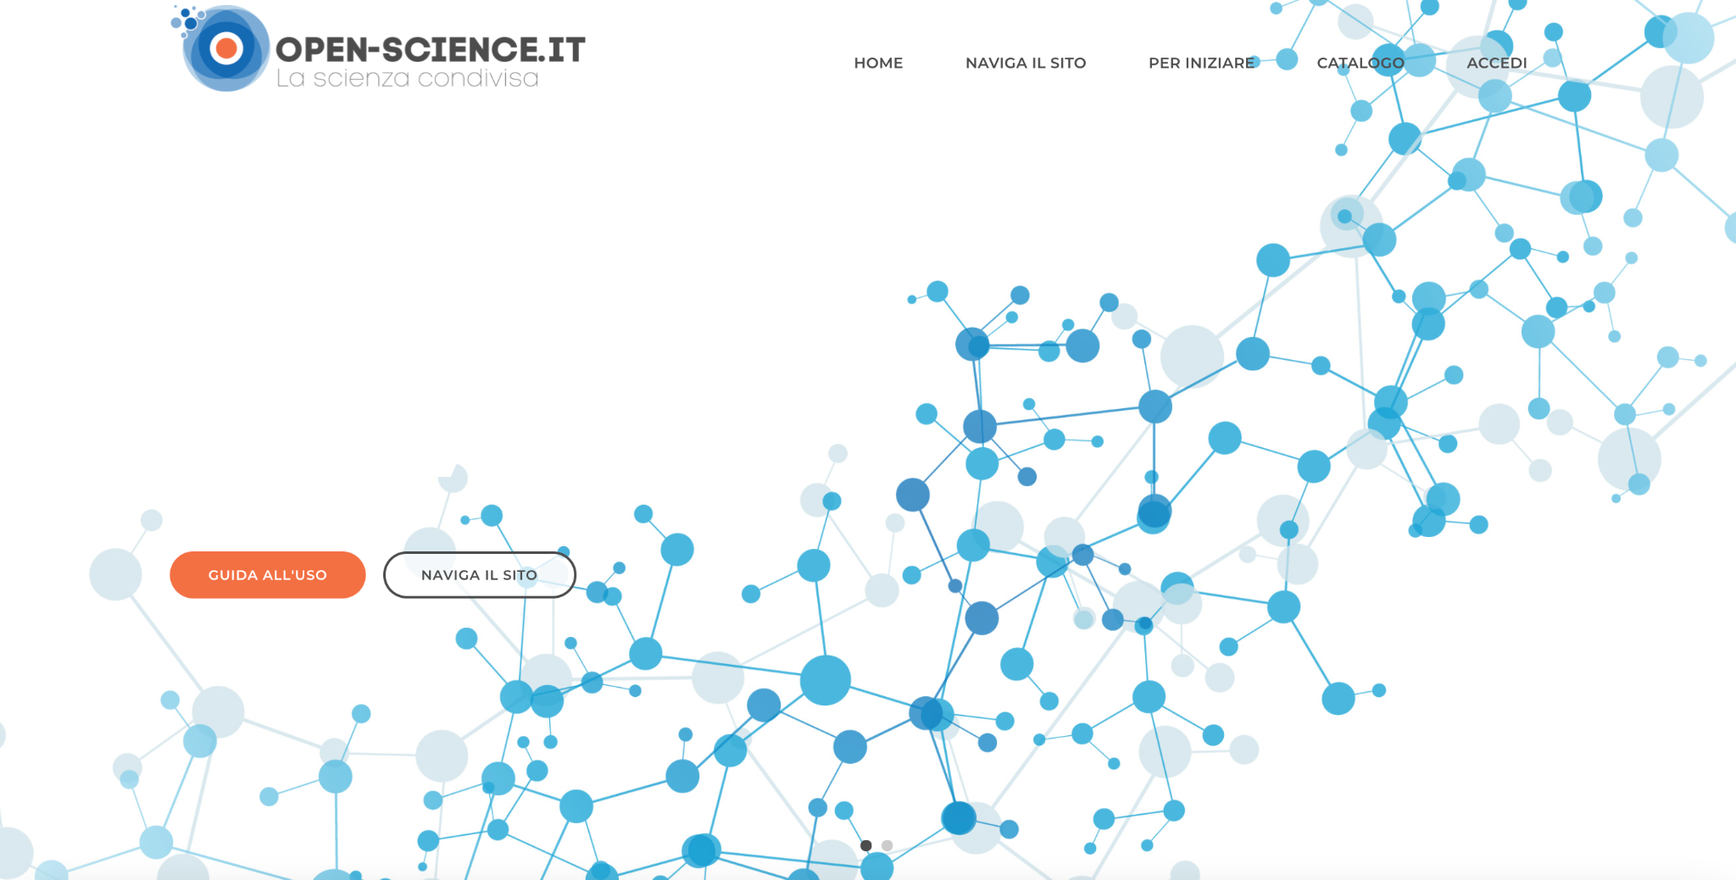
www.open-science.it

Slide 16
A portal on Open Science in Italian
Objective: to inform the Italian community about topics, news and activities on Open Science and its components
Reference point to find relevant materials

Slide 17
The Italian portal on Open Science
Idea and first push to the project: Isti-Cnr
Similar experiences in Europe (France, Netherlands, Portugal, and so on)
Included in the activities of the ICDI Competence Centre with a dedicated Editorial Board
Made by the community,
for the community

Slide 18

Improve findability of content and materials
contents declined from multiple points of view
catalog of resources

Slide 19
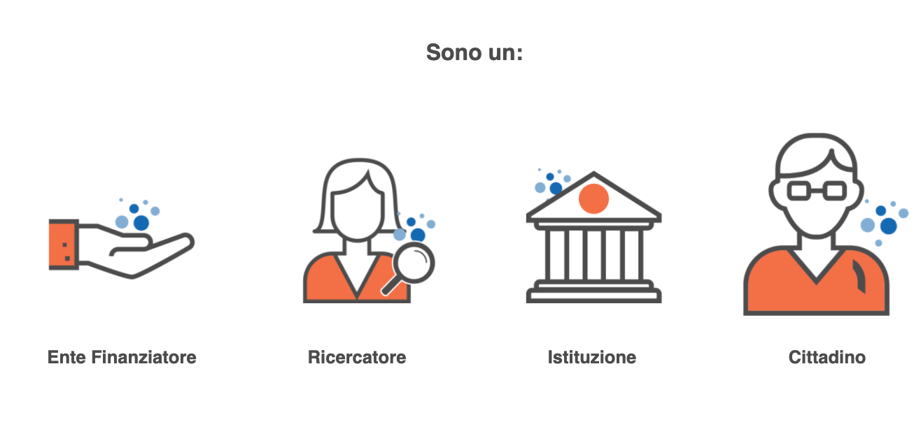
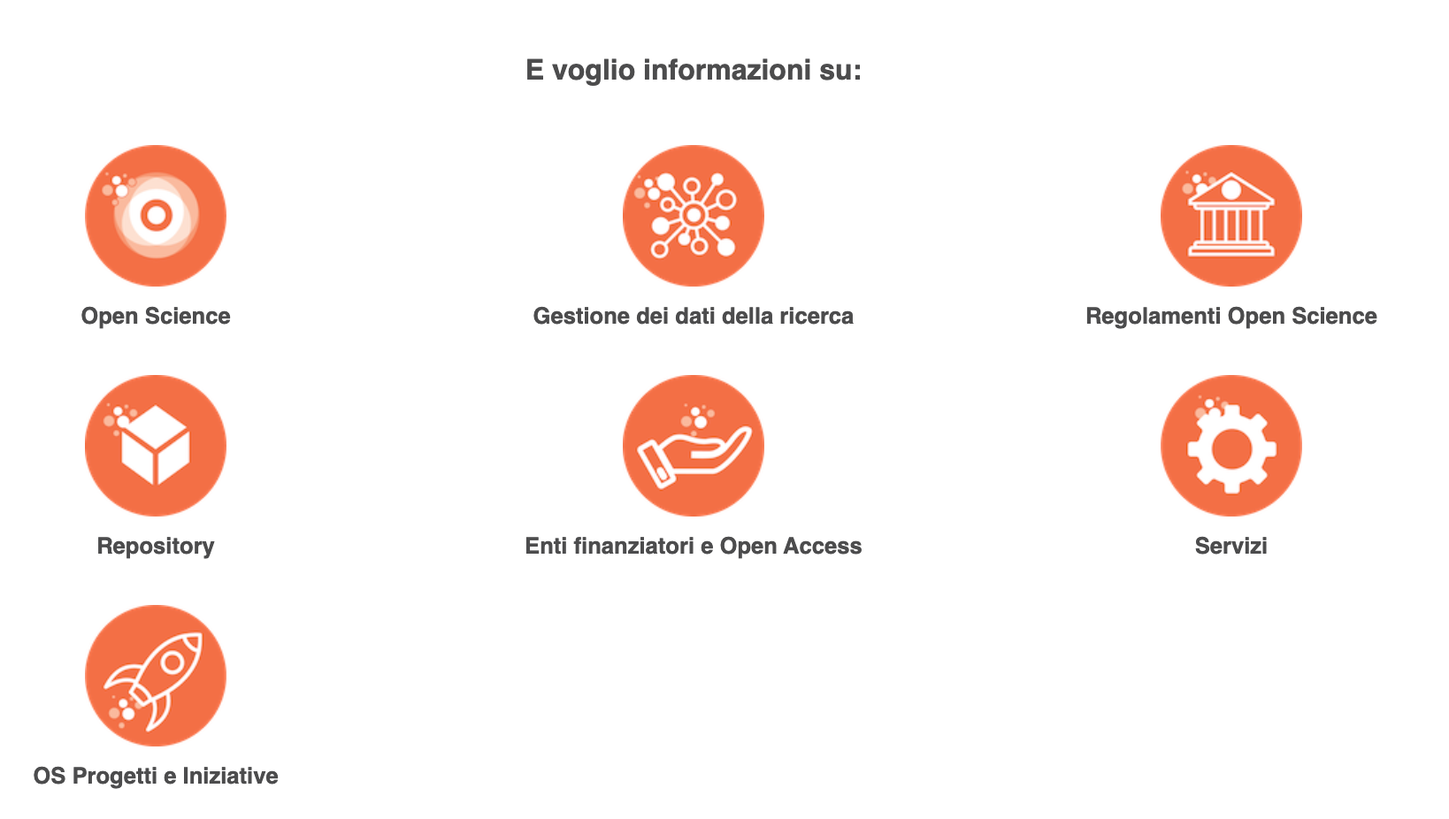
Double navigation menu

Slide 20

Variety of contents
OS/OA basics
How to…
News
Events
Documents and materials
Resource catalogue
Image by Frauke Riether from Pixabay

Slide 21
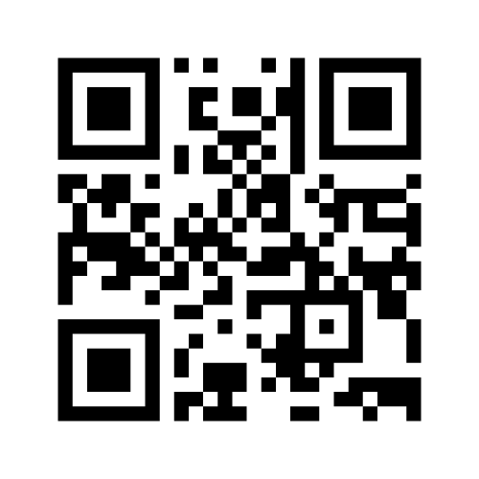
Interact with mentimeter
Please go to www.menti.com and insert code: 9468 8822
OR
use your mobile/tablet to scan the QR code

Slide 22



Many thanks for your attention!
Gina Pavone - gina.pavone@isti.cnr.it
Emma Lazzeri - emma.lazzeri@garr.it

