Slide 1



Open Science
in research projects
More better, Open Science
module 3.1
Gina Pavone 0000-0003-0087-2151
Emma Lazzeri 0000-0003-0506-046X
12 November 2021

Slide 2
Day 3
12 November
1
2
DMP
DMP tools
What it is and how to
build it
Useful resources
3
4
OS in HE
EOSC and RIs
Open Science is the new normal!
What & opportunities

Slide 3
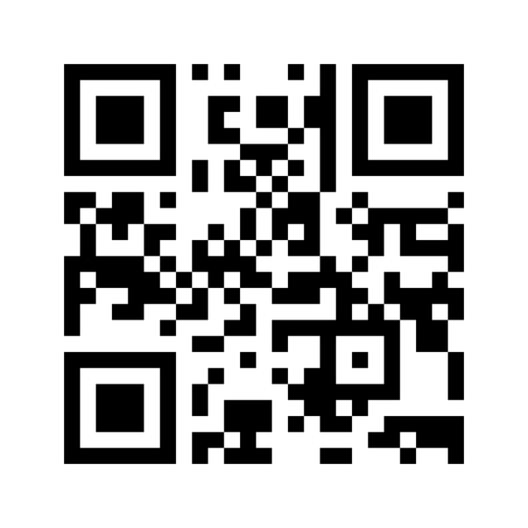
Interact with mentimeter
Please go to www.menti.com and insert code: 2641 3958
OR
use your mobile/tablet to scan the QR code

Slide 4
The data Management plan

Slide 5
What is a DMP?
A Data Management Plan is a document specifying how research data will be handled both during and after a research project.
It identifies key actions and strategies to ensure that research data are of a high-quality, secure, sustainable, and – to the extent possible – accessible and reusable.
quoted from: https://www.ugent.be/en/research/datamanagement/before-research/datamanagementplan.htm
A Key tool for proper Research Data Management

Slide 6

Why does DMP has to be done?
For oneself!
The DMP is a structured approach to data management: instead of improvising when a need arises, thoughtful choices are made across the entire data lifecycle.
Save time and try to prevent problems in the future
Estimate costs
See also: https://open-science.it/article?rpk=101032&prs_sel=p_researcher&tpc_sel=t_gestione_dei_dati_della_ricerca (in Italian)
Image by Peggy und Marco Lachmann-Anke from Pixabay

Slide 7
Why does DMP has to be done?
For others and for mandates!
Mandates
Ethics
GDPR
It is mandatory in EC and ERC funded projects
Also other funders ask for it
DMPs may also be required as part of the ethical approval process
Even if a full DMP is not required, a record of processing activities is needed to comply with the GDPR when working with personal data.

Slide 8
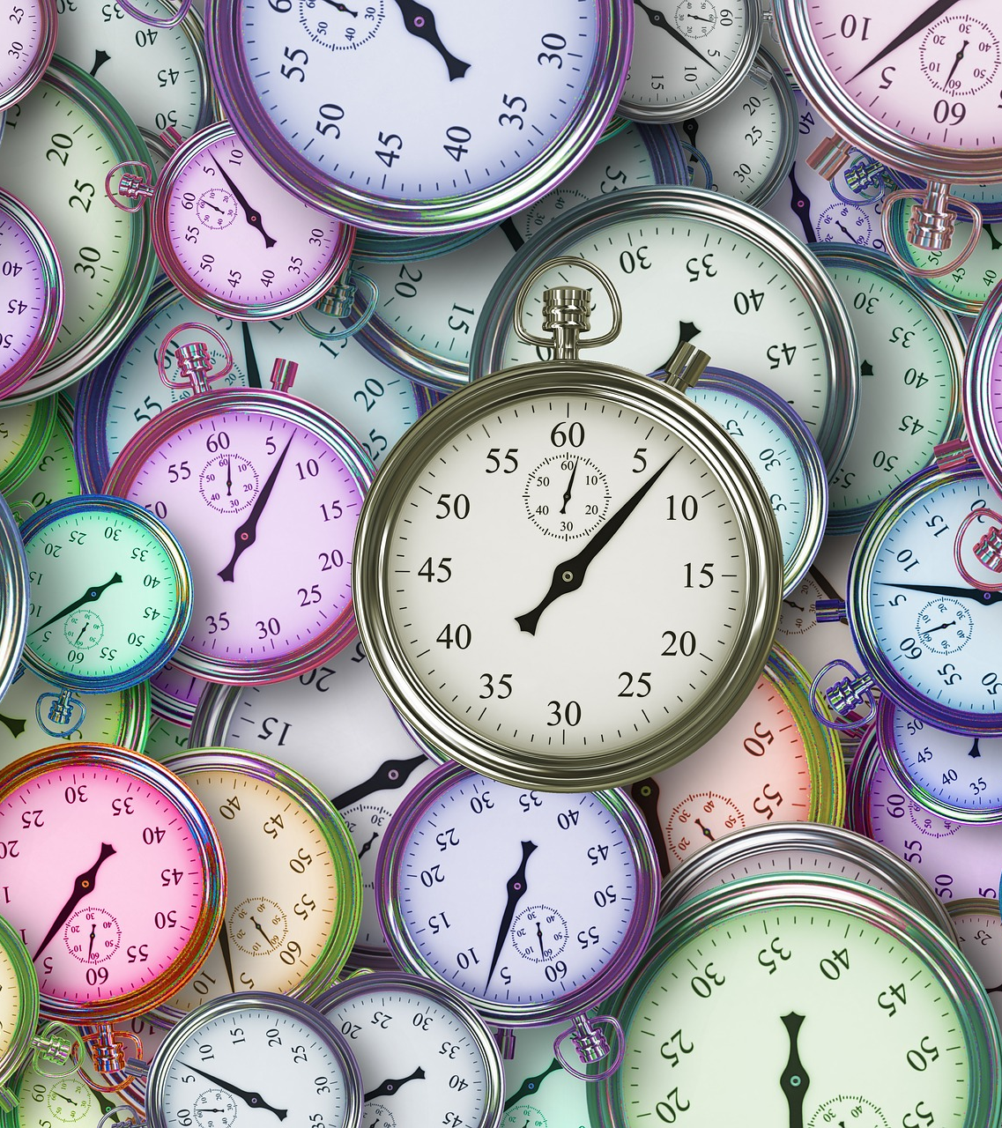
When the DMP has to be done?
Before or at early stage of the research activity

Slide 9

The DMP is a living document!
Update it where necessary in the course of the project!
You may not know all the answers at the outset, and circumstances may change.
Photo by kazuend on Unsplash

Slide 10
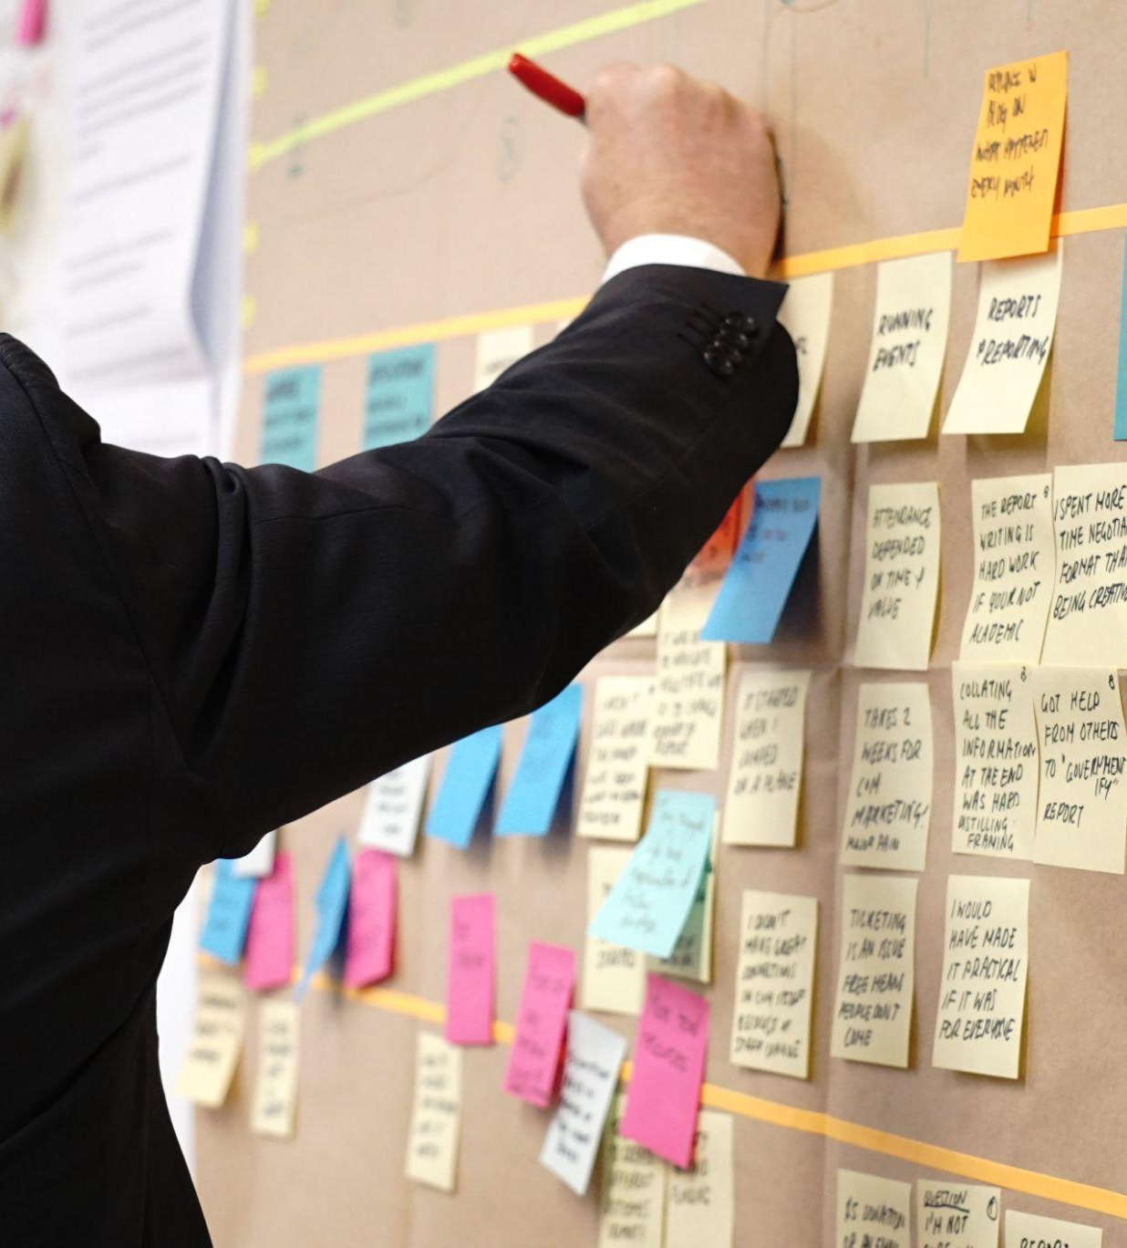
What is normally a DMP about?
Identify the data you are working with in your project
Decide the strategy to organise your data and the standards you will use
Daily data management
  What is your plan for sharing your data?
  Will you have issues sharing your data?
  Will you need more resources/budget than expected?
Photo by Jo Szczepanska on Unsplash

Slide 11
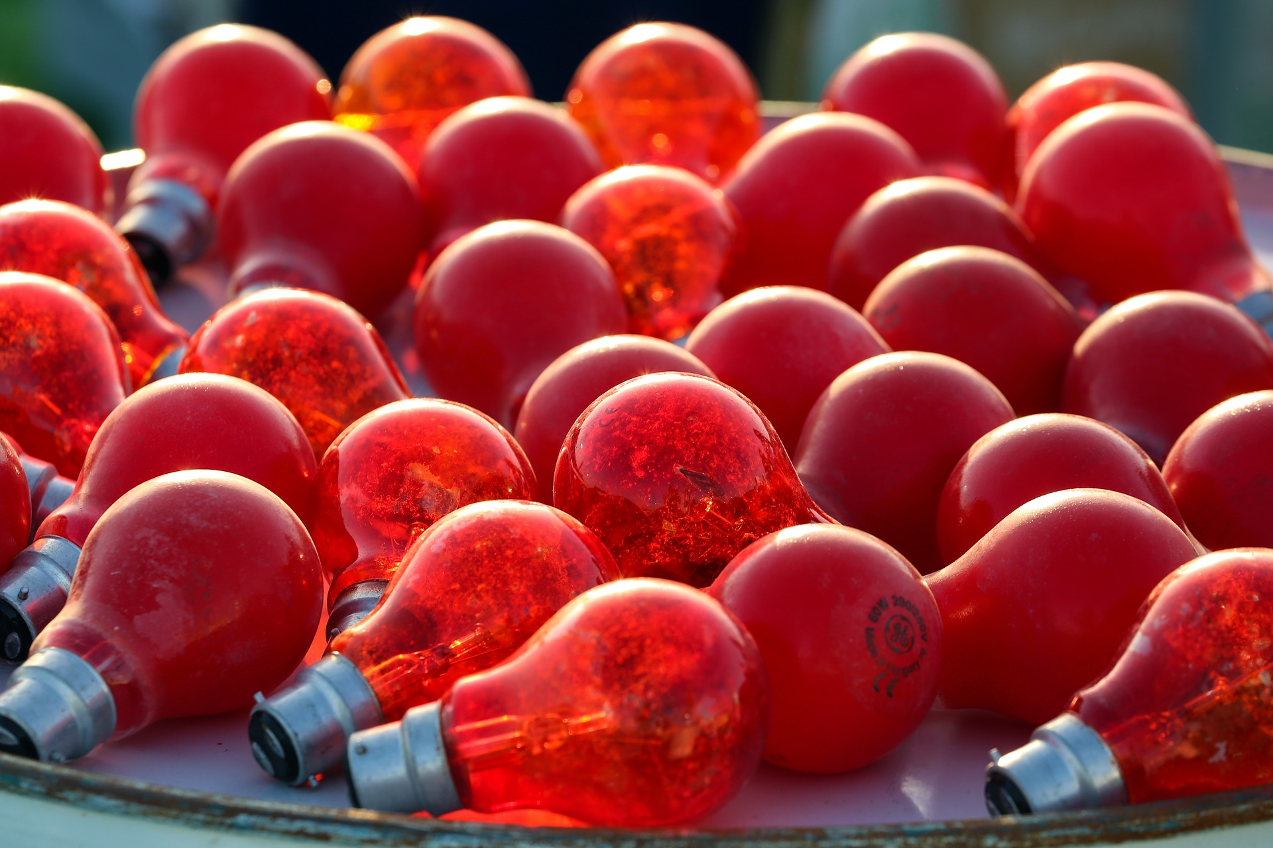
Topics and aspects to address in a DMP

Slide 12
Data collection
Research data can be gathered through observation, manual or automatic measurements in the laboratory or in the field, with remote sensing techniques, by interviews, by modelling and simulation, etc. Data can also be stored in many formats.
Considering what data will be collected, generated, and/or reused, and how you will organize them
This slide and some of the following are build reusing and manipulating parts of the Ghent University guide to RDM: https://www.ugent.be/en/research/datamanagement

Slide 13
Data collection: file formats
File format:
how information is stored within a digital file
the format of a file is indicated by the ‘extension’ in the filename (e.g. .txt, .csv)
The choice of file formats to use depends on:
Discipline-specific standards and customs
Planned data analyses
Software availability/cost
Hardware used
Risks
Formats which can only be used within specific software makes the digital data vulnerable to obsolescence of the software
Beware to file converting!
Best practices:
Non-proprietary (not protected by trademark, patent or copyright)
Open, documented standard
Common usage by research community
Standard representation (ASCII, Unicode)

Slide 14
Data collection: file naming
A file name is the principal identifier of a file.
Good file names should:
Provide useful cues to content, status and version
Uniquely identify a file
Help to classify and sort files
File names can be constructed using the following elements:
Project acronym
Content description
Date
Location
Creator name/initials
Status information (i.e. draft or final) etc
Notes:
File names that reflect the content of the file will facilitate searching, discovering and understanding of the data.

Slide 15
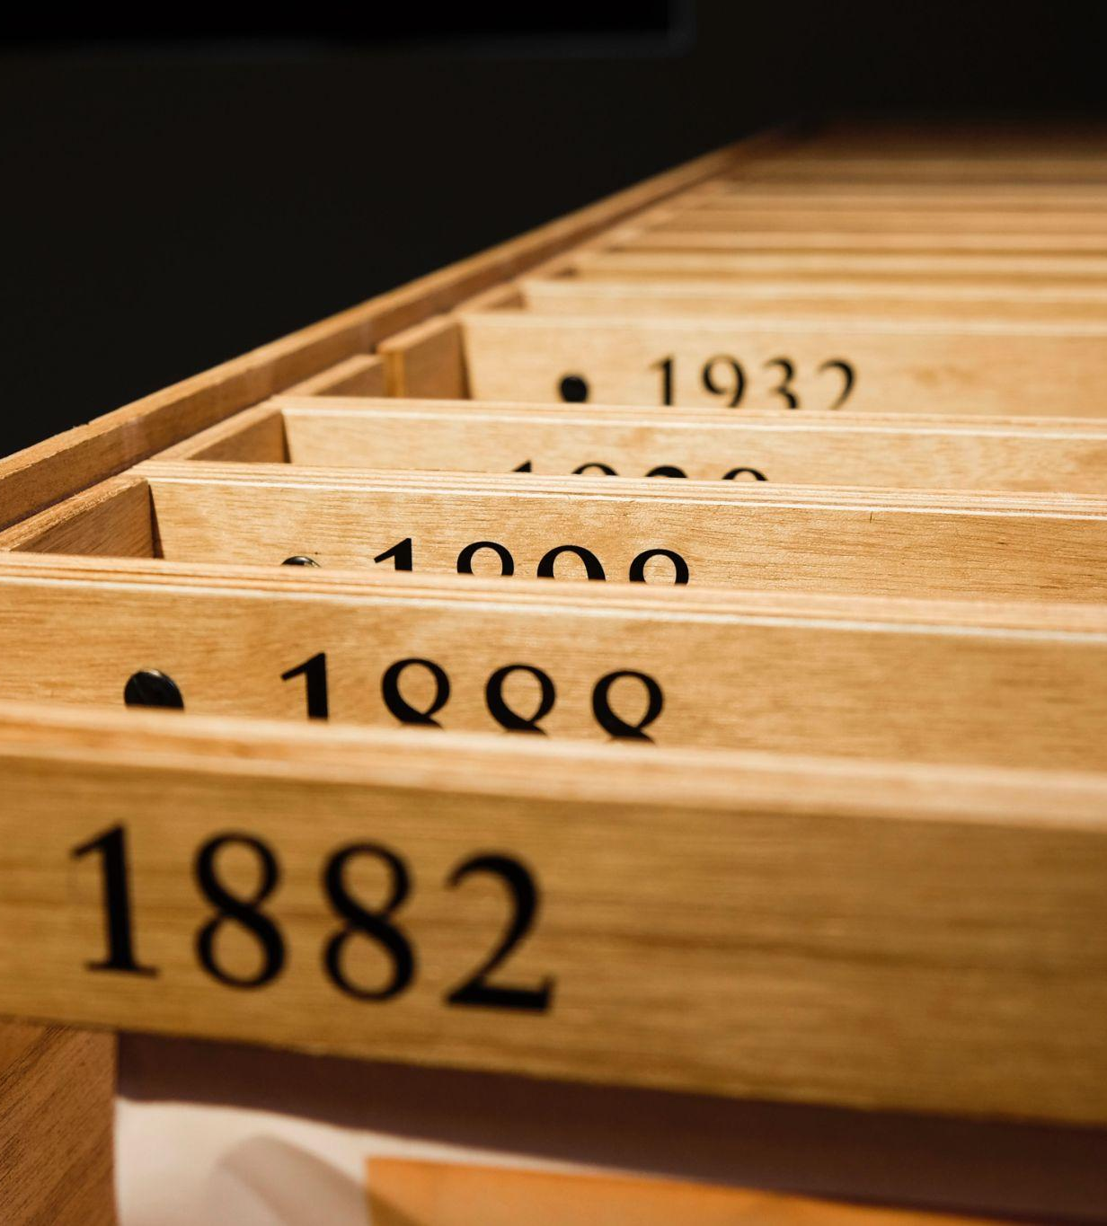
File naming: decide with your colleagues!
It can be useful if the consortium/department/group agrees on the following elements of a file name:
Vocabulary – choose a standard vocabulary for file names, so that everyone uses a common language
Punctuation – decide on conventions for if and when to use punctuation symbols, capitals, hyphens and spaces
Dates – agree on a logical use of dates so that they display chronologically i.e. YYYY-MM-DD
Order - confirm which element should go first, so that files on the same theme are listed together and can therefore be found easily
Numbers – specify the amount of digits that will be used in numbering so that files are listed numerically e.g. 01, 002, etc.
https://www.data.cam.ac.uk/data-management-guide/organising-your-data

Slide 16
Data collection: folder structure
Information on a topic is located in one place
Are there established approaches in your team or department?
Name folders appropriately - i.e. name folders after the areas of work to which they relate
Structure folders hierarchically - limited number of folders for the broader topics, and then create more specific folders within these
Consider separating ongoing and completed work
Backup – ensure that your files, whether they are on your local drive, or on a network drive, are backed up
https://www.data.cam.ac.uk/data-management-guide/organising-your-data

Slide 17
Documentation
Study level documentation:
Contextual information (the background, aims, objectives, the hypotheses etc)
Procedural & methodological information
Data level documentation:
Information about datasets and/or individual data items
Information about variables, derived data, aggregated data etc
One of the basics of RDM. It enables you to understand/interpret data later

Slide 18
Legal and ethical issues
Do you have to protect confidentiality?
Are there requirements from an ethical committee?
Have you an informed consent to distribute and get signed?
Have you an idea of the anonymization tool to use?
Especially when the research is handling personal or sensible data

Slide 19
Storage and backup
Provide information on the type of storage is going to be used for the project data (storage on local devices, network storage - i.e. in your institution - or cloud storage)
Specify in which phase you want to use one type or another of storage
Data should be safe!

Slide 20
Data preservation
Specify if data will be selected for deposit (ie. raw data, processed data…) - you can update this part later!
Detail on the Research Data repository
Detail on non-digital data and materials
Keeping data available and usable in the longer term, beyond the end of your research project

Slide 21
Costing
Infrastructure costs:
Digitisation
Storage
Licensing and Security
Sharing and Re-use
Archiving
Skill costs:
Data wrangling
Description and Documentation
Metadata generation
Formatting and Cleaning
Consent and Anonymisation
Both in time and money!
https://www.openaire.eu/rdm-researcher-costs-infographic/view-document

Slide 22
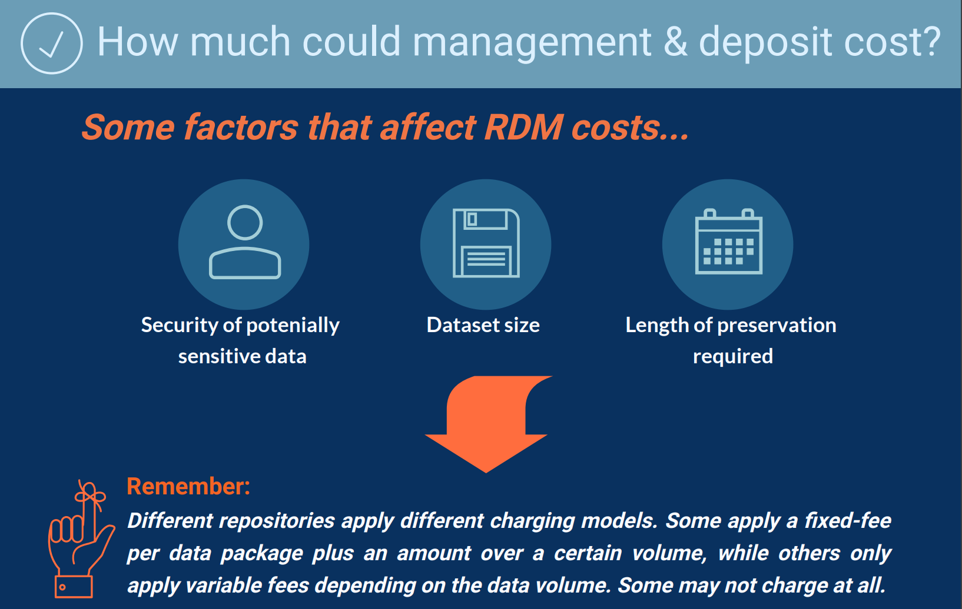
https://www.openaire.eu/rdm-researcher-costs-infographic/view-document

Slide 23
Data sharing
Details on access: if data will be open, restricted, closed or embargoed
Details and motivation for non-open data
Information on access conditions (if restricted - ie. email, form or whatever)
Use of persistent identifiers
Information on licences
Make publicly available (outside project or research team)

Slide 24
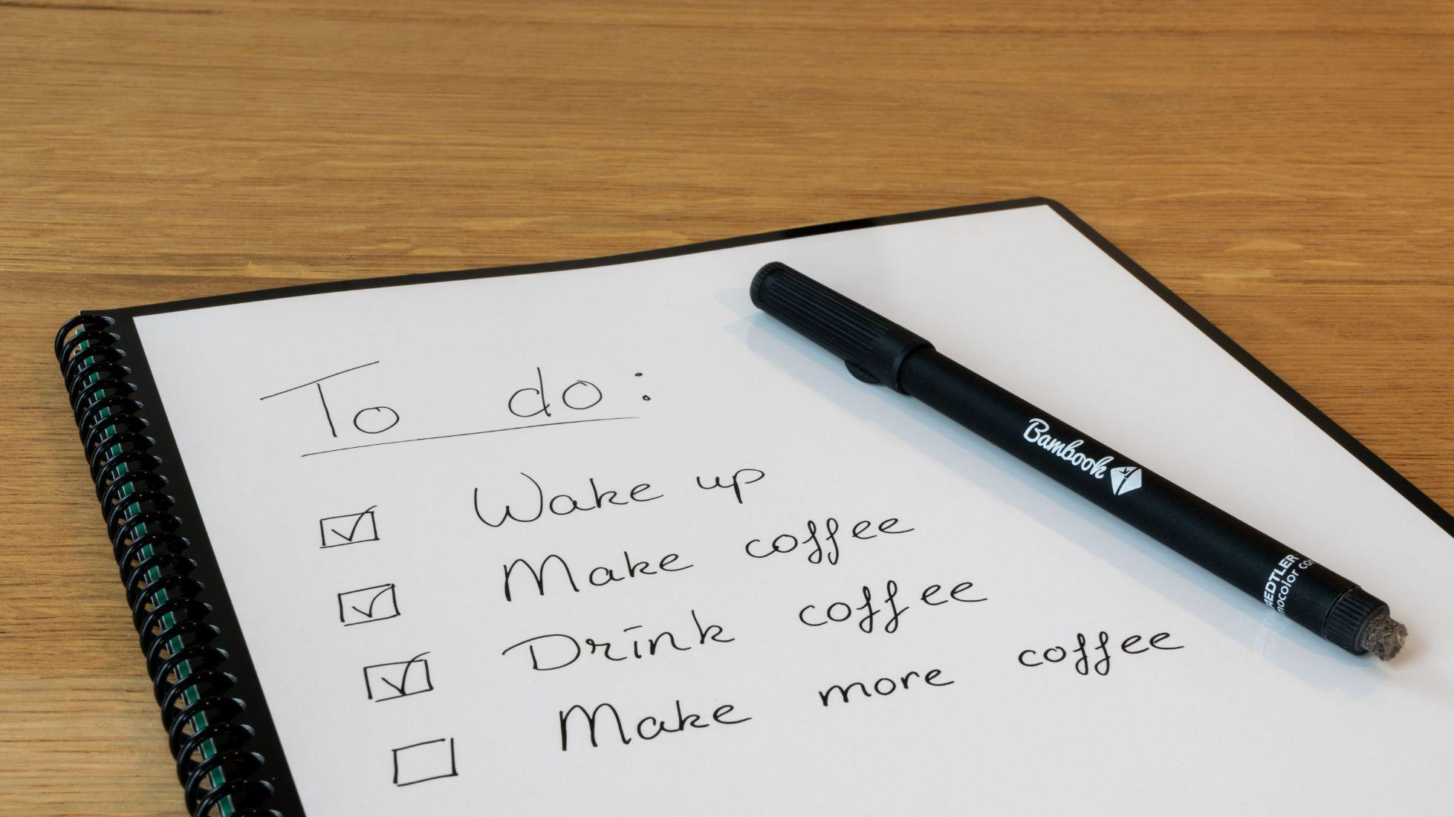
Data Management Plan Checklist
One of the million available...
Photo by Thomas Bormans on Unsplash

Slide 25
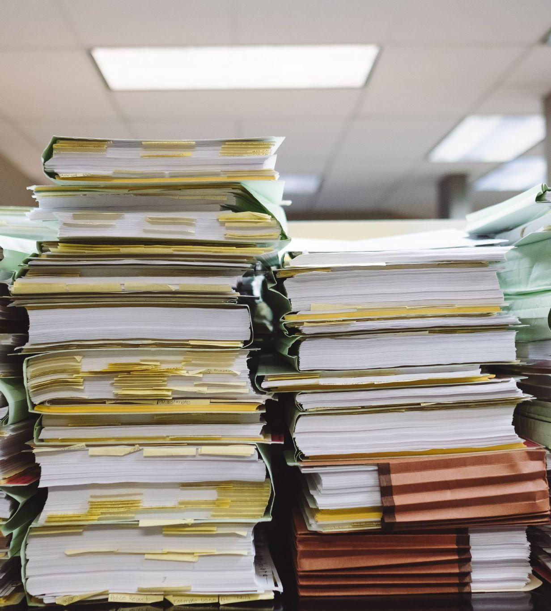
Administrative Data
Basic information about your project: title, acronym, ID, reference numbers
An abstract of your project highlighting the scope of data collection/creation
Details related to procedures and policies
Photo by Wesley Tingey on Unsplash

Slide 26
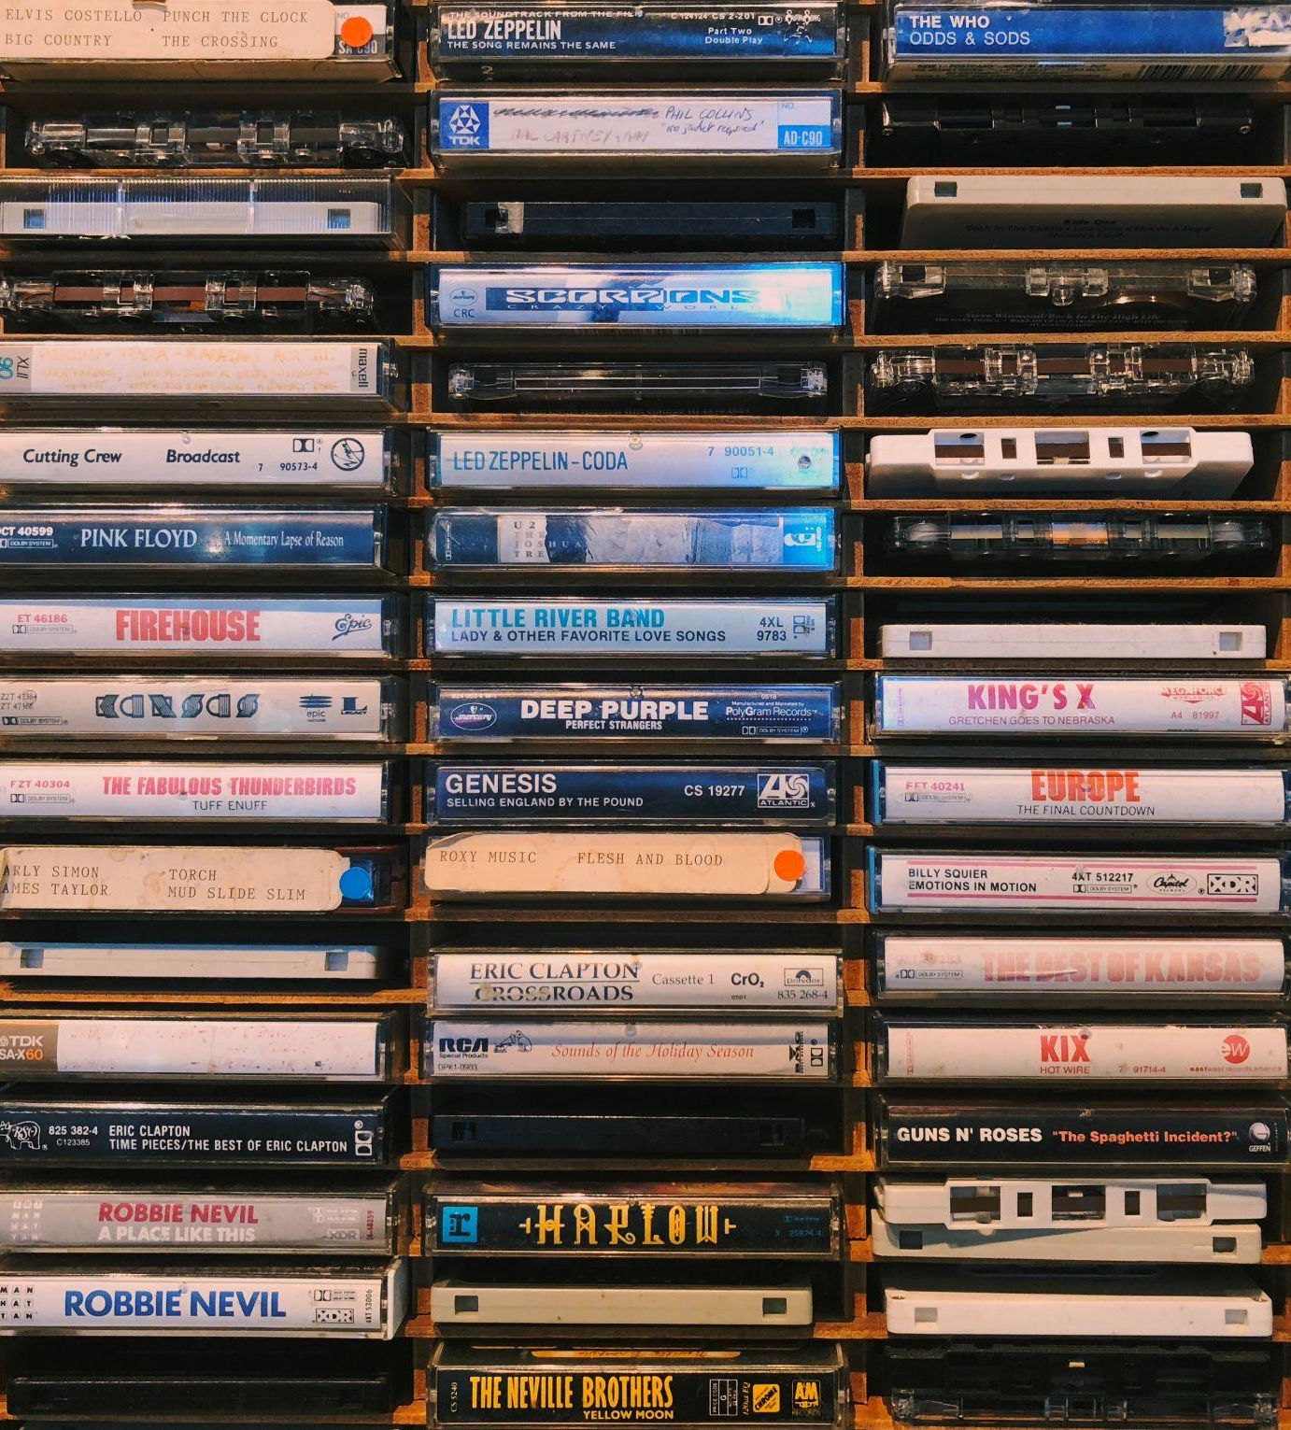
2. Data Collection
Are you using existing data?
What are the standards or methodologies that you will use to collect your data?
Data Formats and Software
How will you structure and name your files and folders?
Photo by Jon Tyson on Unsplash

Slide 27
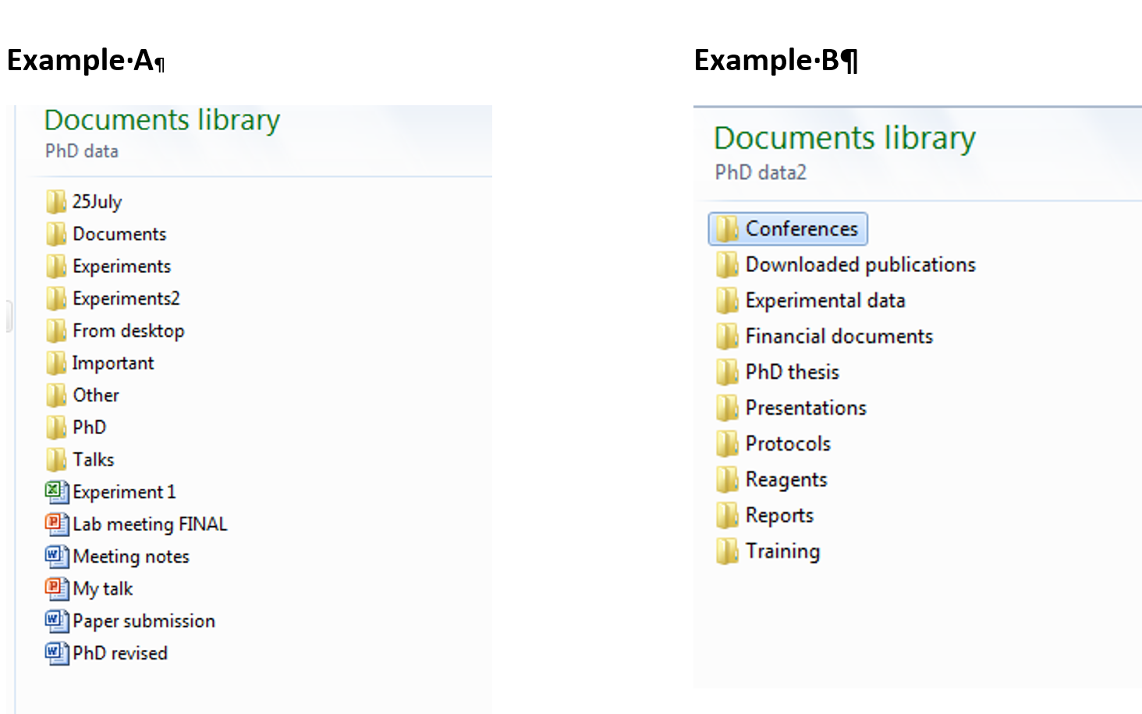
Folder structure: what is your strategy?

Slide 28
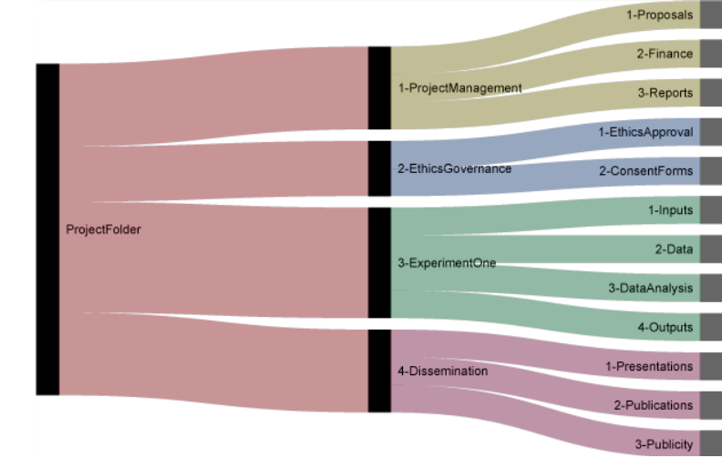
A good example
http://nikola.me/folder_structure.html

Slide 29
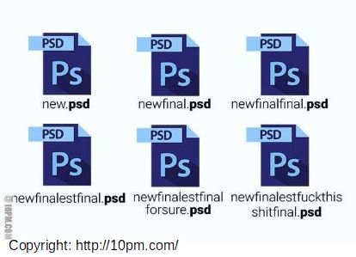
File naming

Slide 30
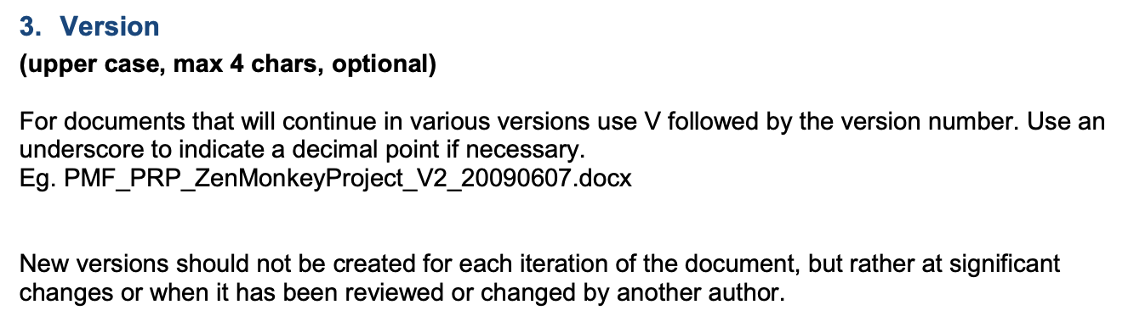
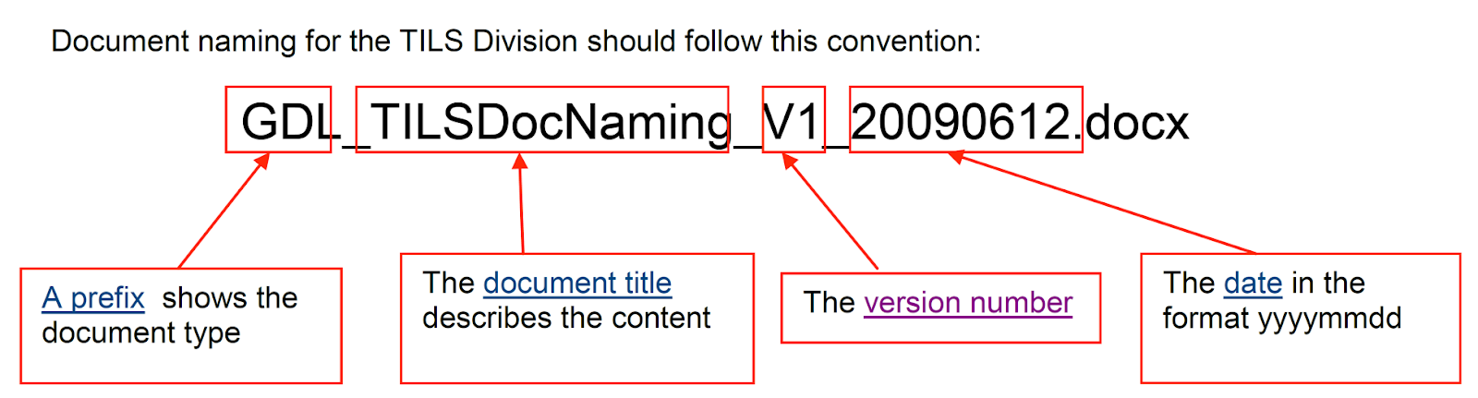
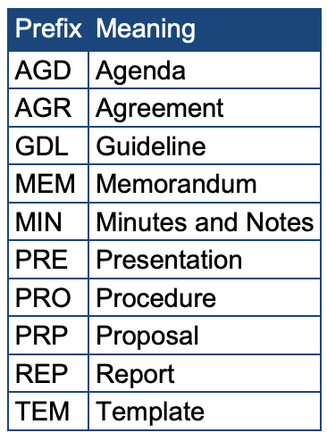
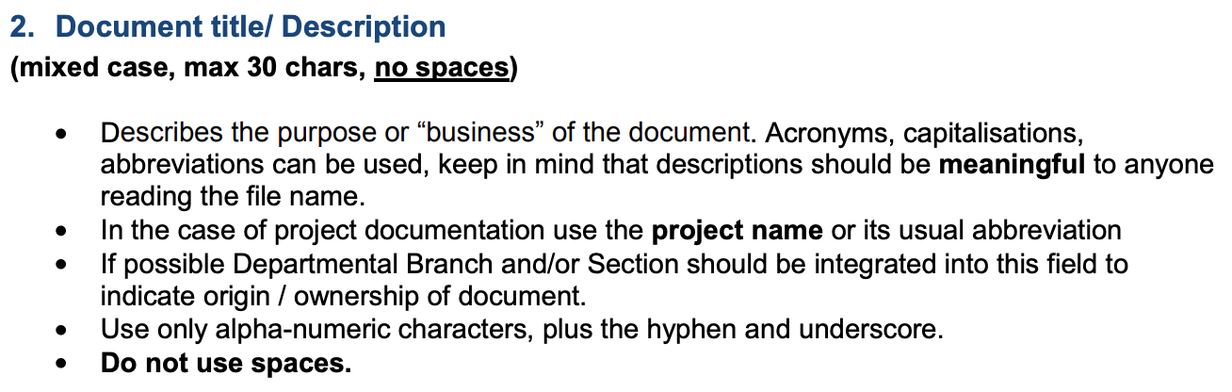
A good example
http://www.data.cam.ac.uk/files/gdl_tilsdocnaming_v1_20090612.pdf

Slide 31
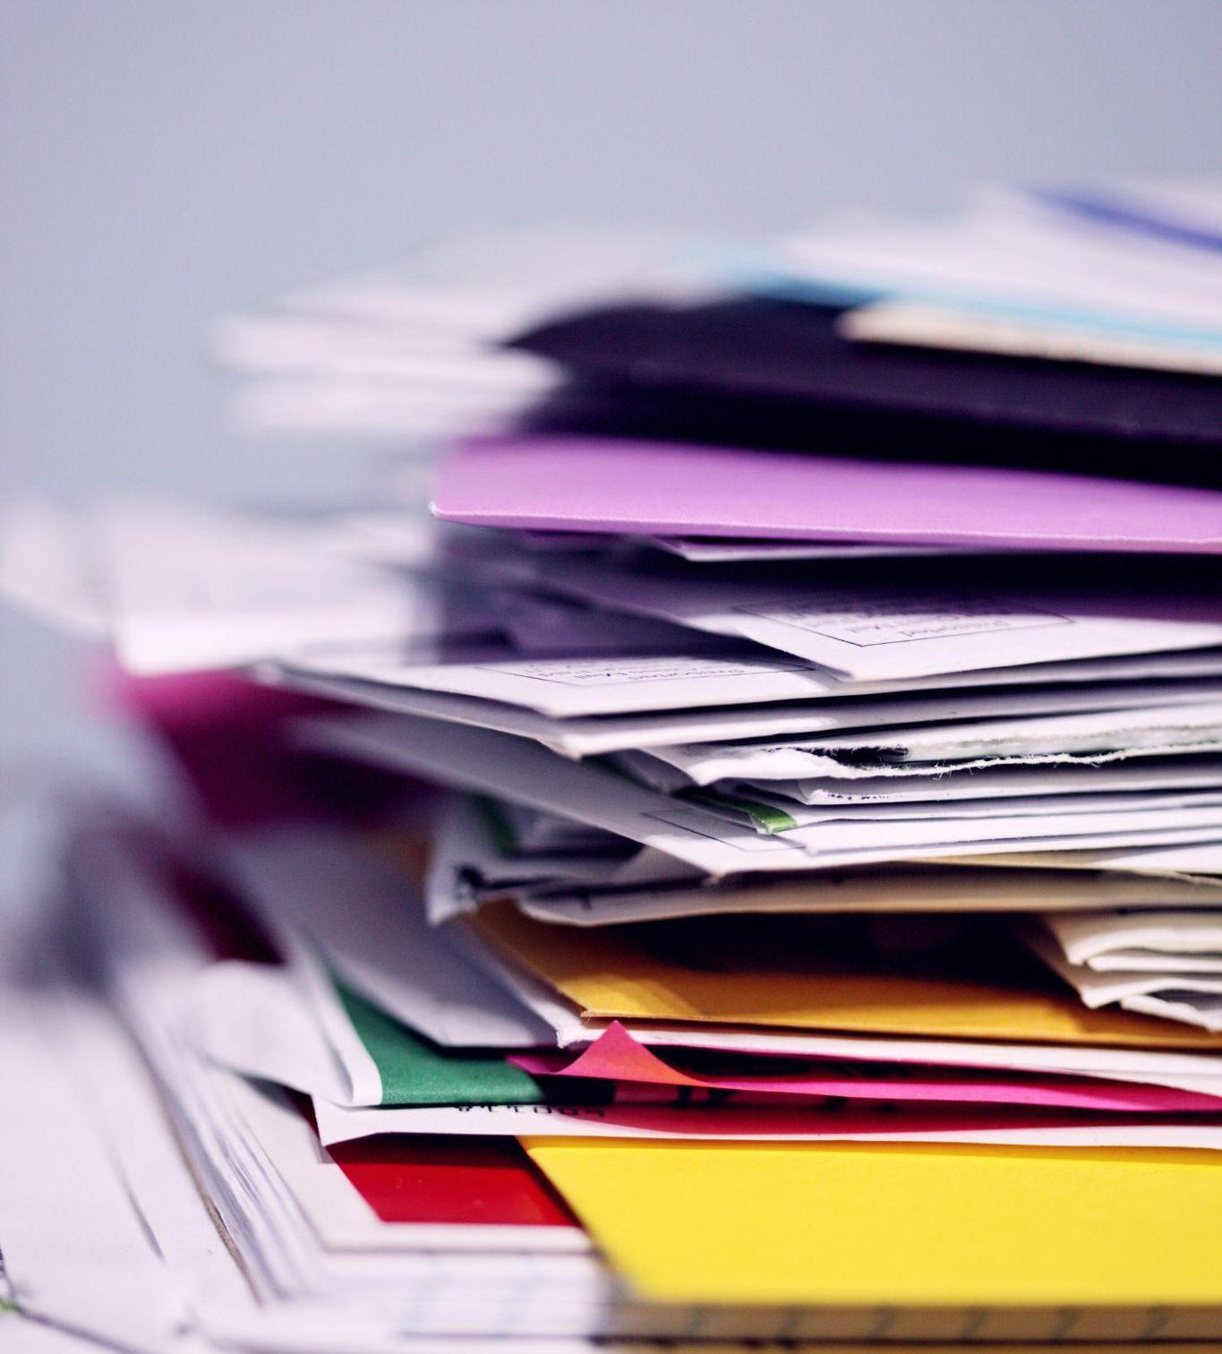
3. Metadata and Supporting Documentation
Which documentation and metadata will support/describe your data?
How will you create the supporting documentation and metadata?
Which metadata standards will you use?
Photo by Sharon McCutcheon on Unsplash

Slide 32
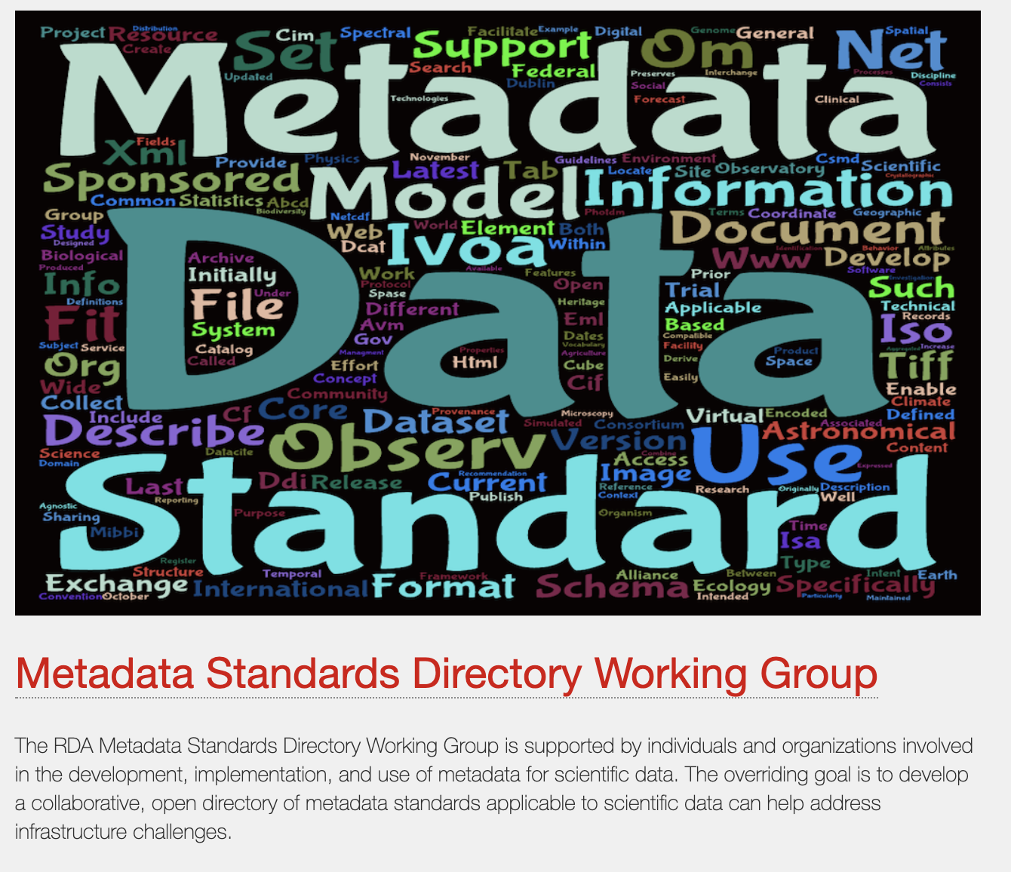
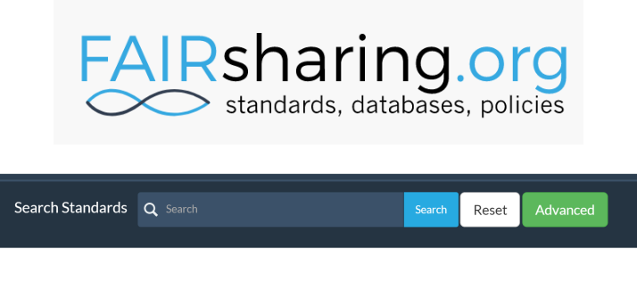
Discipline Specific Standard
https://fairsharing.org/standards/
http://rd-alliance.github.io/metadata-directory

Slide 33
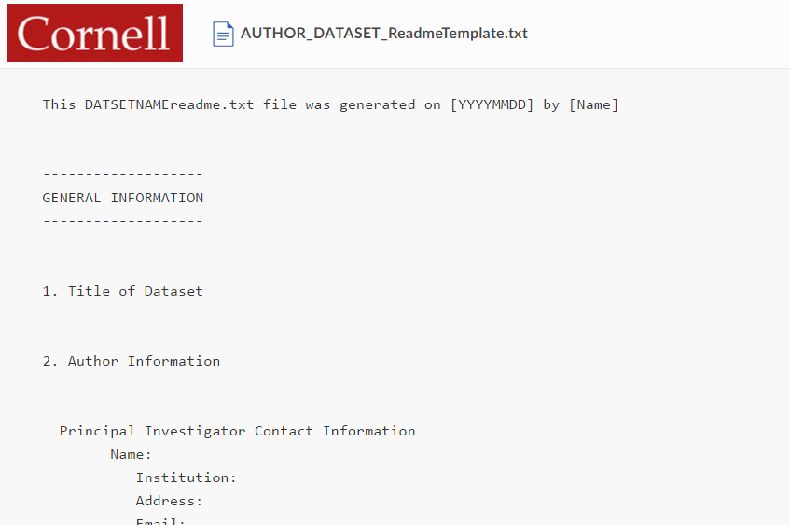
So many ways to describe your data
How to create useful README files: https://data.research.cornell.edu/content/readme
A readme file describes your data
Use a readme file for those data type that
do not have a metadata standard available
README files template:
https://cornell.app.box.com/v/ReadmeTemplate

Slide 34
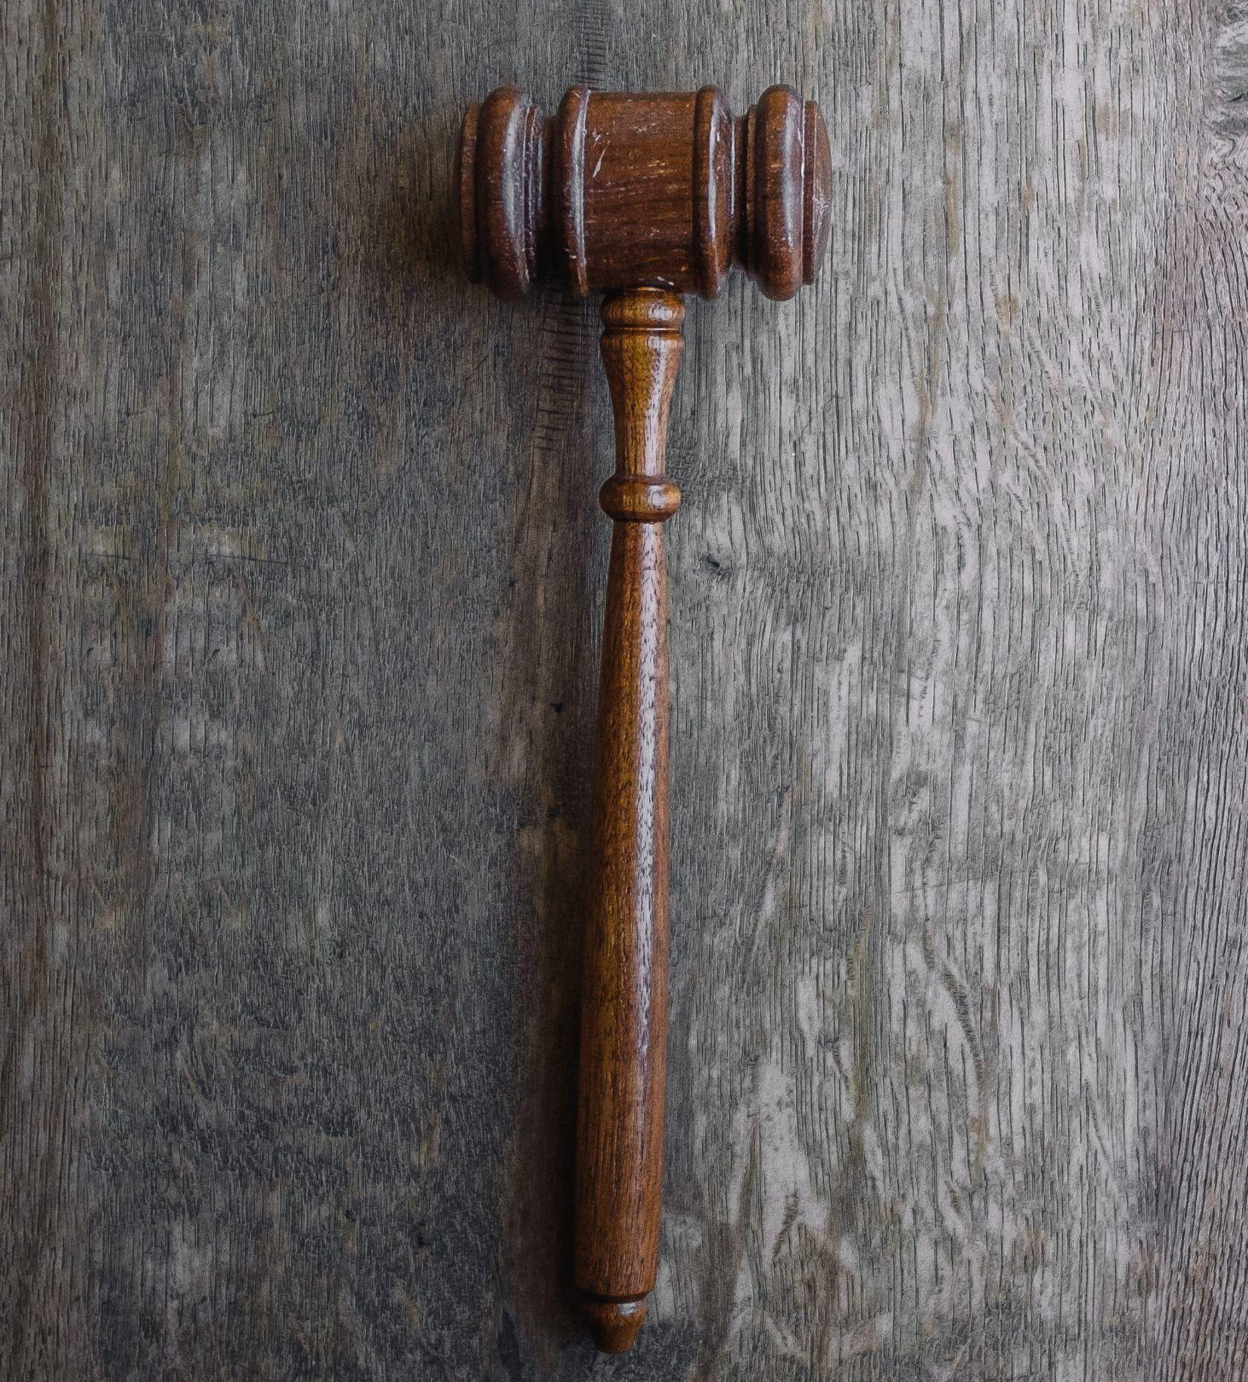
4. Legal and Ethical Aspects
Did you ask for an informed consensus to share the data and preserve them?
How will you protect personal data?
How about data licencing?
Photo by Wesley Tingey on Unsplash

Slide 35
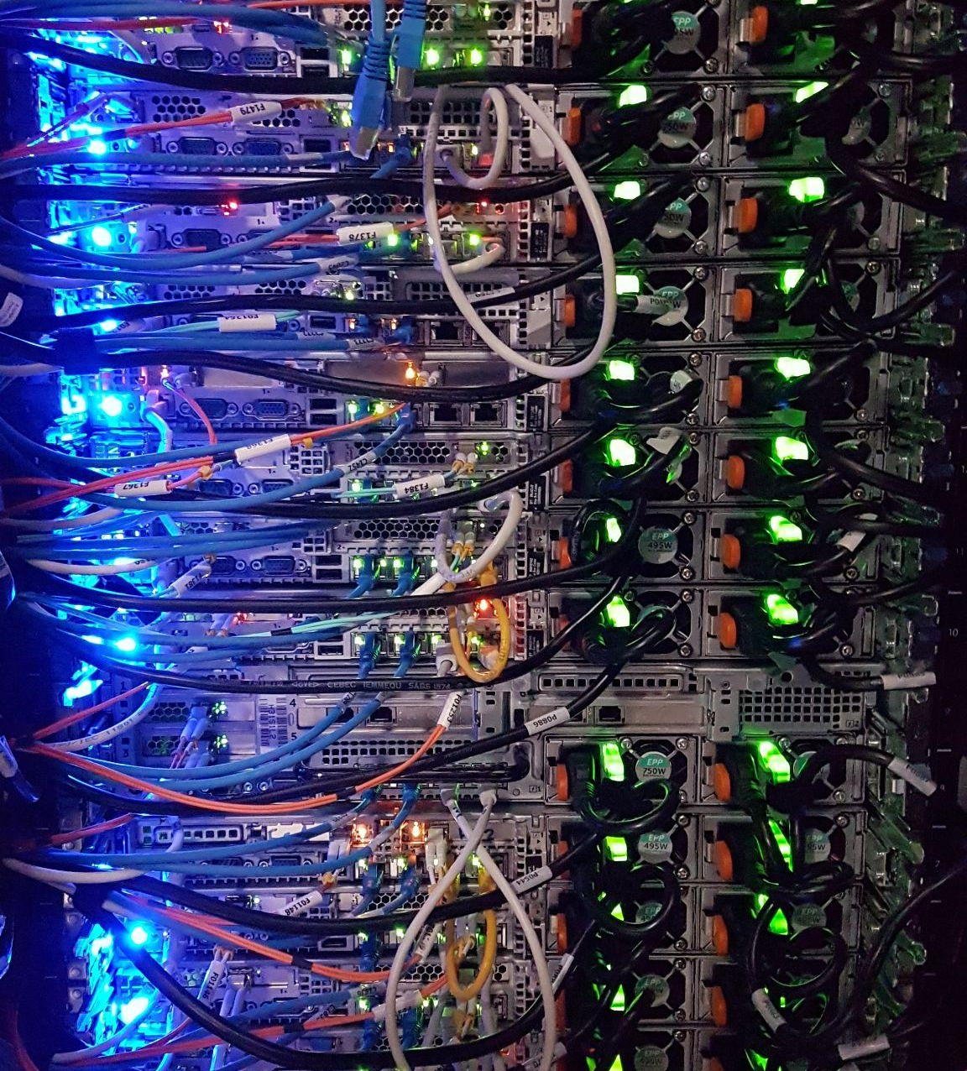
5. Data Storage and Backup
Do you have enough space to store your data or should you include costs for additional services? Will the services be reliable/trusted?
How will you share your storage/backup with your collaborators?
Will you use cloud solutions?
Will you back your data up? How?
Photo by Massimo Botturi on Unsplash

Slide 36
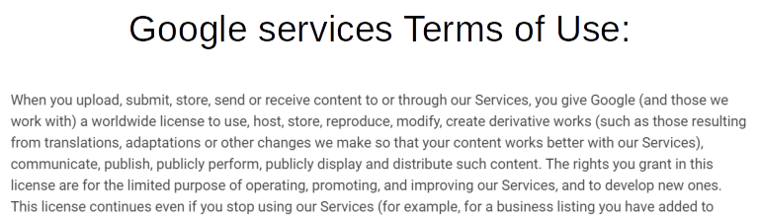
Do not leave it all to Google
https://policies.google.com/terms?hl=en

Slide 37
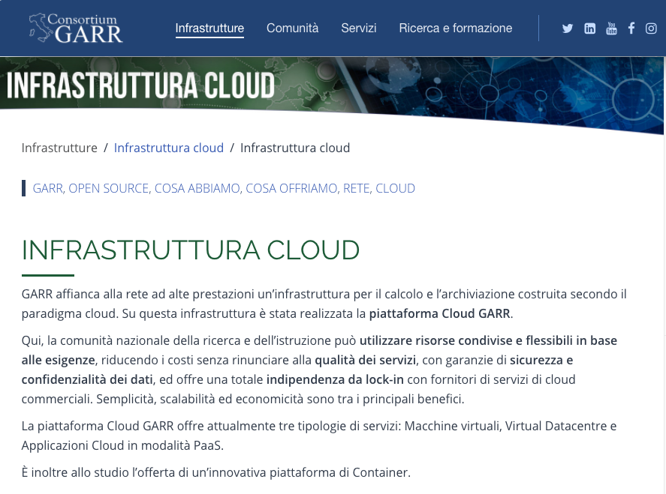
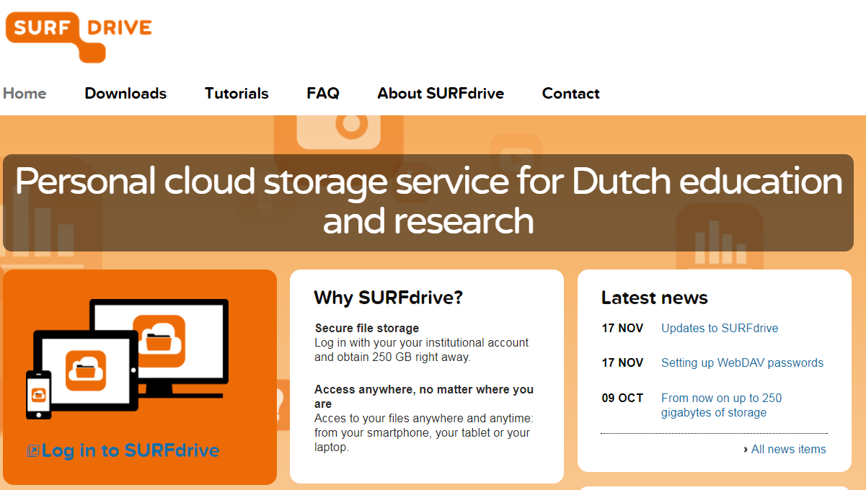
You have better alternatives...
Your institution probably provides better alternatives:
Ask your IT for support!
https://www.garr.it/it/infrastrutture/infrastruttura-cloud/infrastruttura-cloud

Slide 38
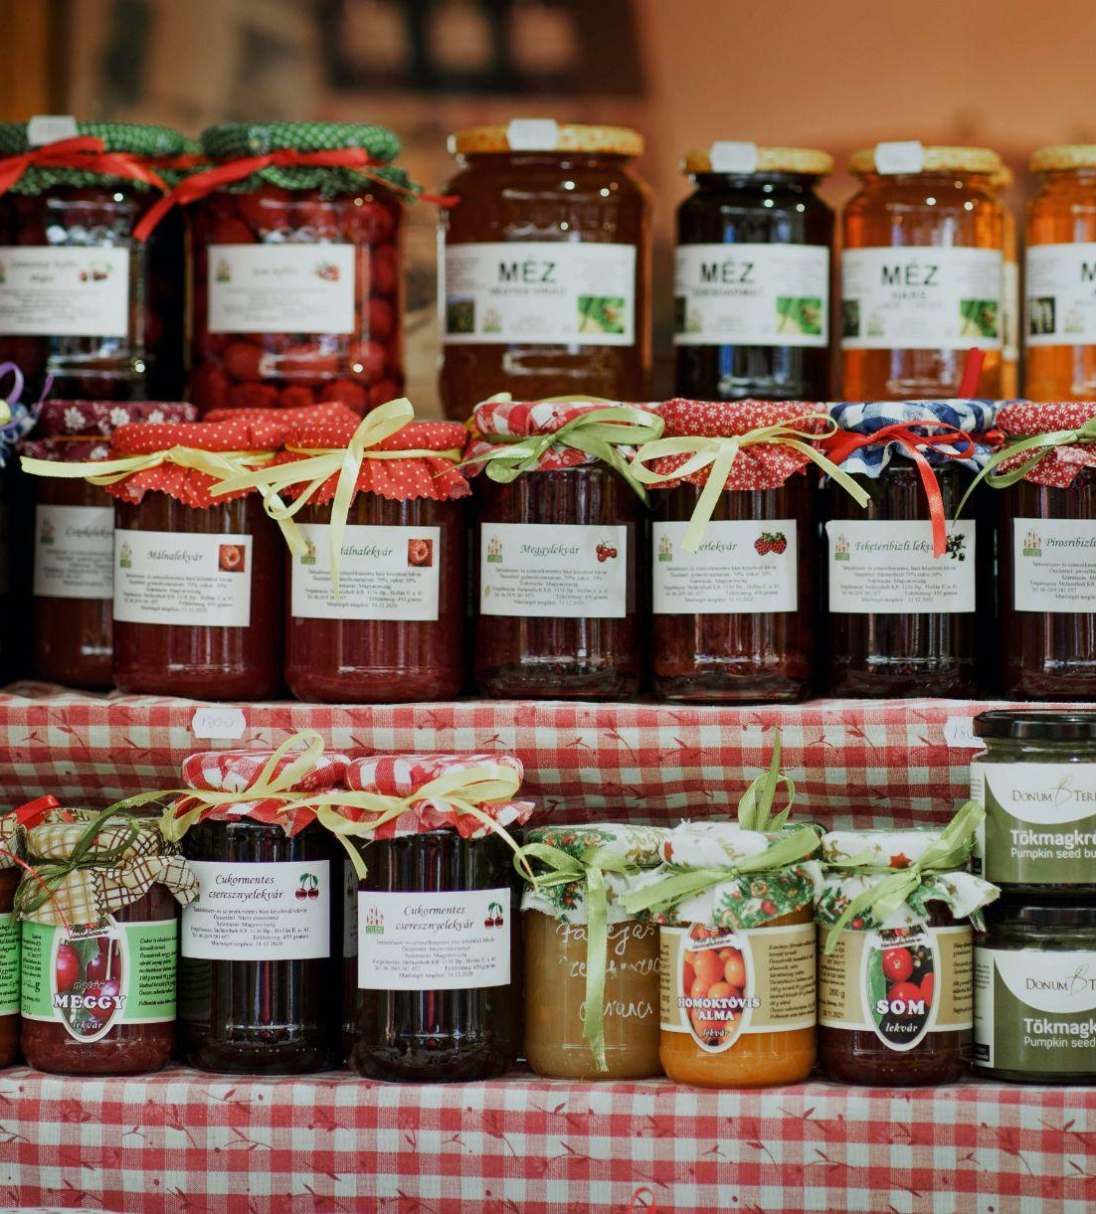
6. Select and Preserve
Which data shall be preserved or destroyed due to contractual, legal or administrative reason?
What are the envisaged uses of your data for research purposes?
Which data shall be preserved and potentially shared?
What is your long term preservation strategy?
Did you consider the effort and costs to prepare your data for sharing and preservation?
Photo by Paréj Richárd on Unsplash

Slide 39

7. Data Sharing
Who will you share your data with? Under which conditions?
When will you share your data?
Will you need to apply any access restriction?
Which actions do you foresee to avoid or reduce access restrictions?
How will your potential users find your data?
Photo by Markus Winkler on Unsplash

Slide 40
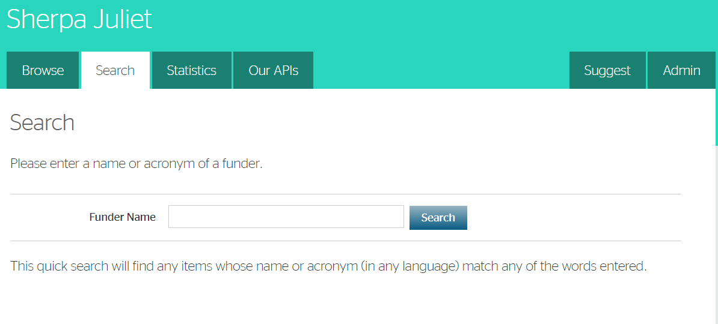
Funder policies
https://v2.sherpa.ac.uk/juliet/

Slide 41

Software sharing
https://guides.github.com/activities/citable-code/

Slide 42
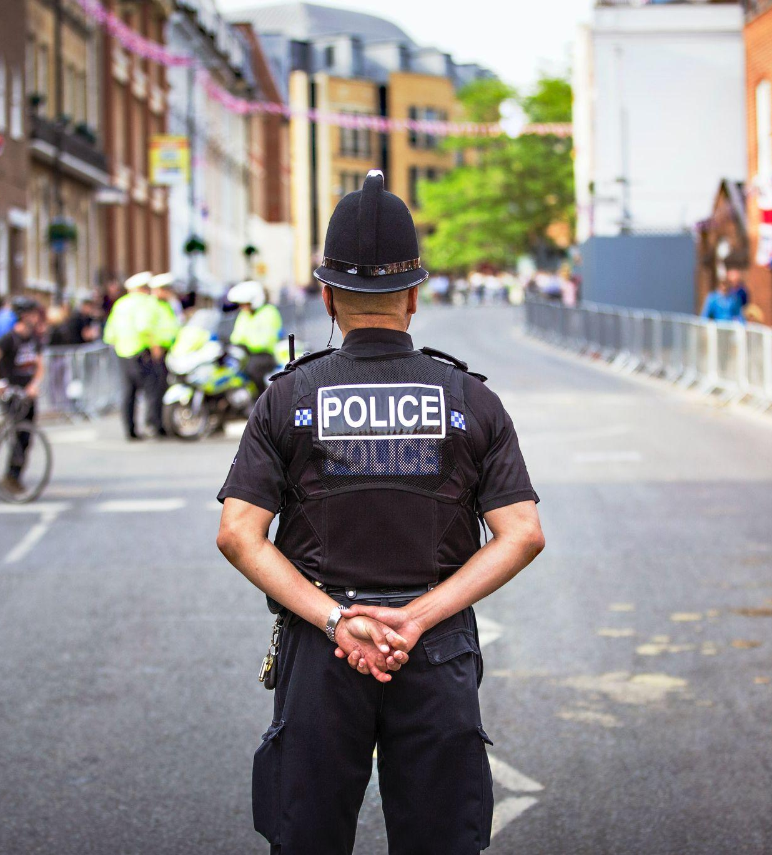
8. Responsibilities and Resources
Who is responsible to implement and revise the DMP?
How will you share responsibilities among partners in collaborative projects?
Which resources will you need to implement your DMP?
Will you need any specific external expertise or tools?
Photo by King's Church International on Unsplash

Slide 43
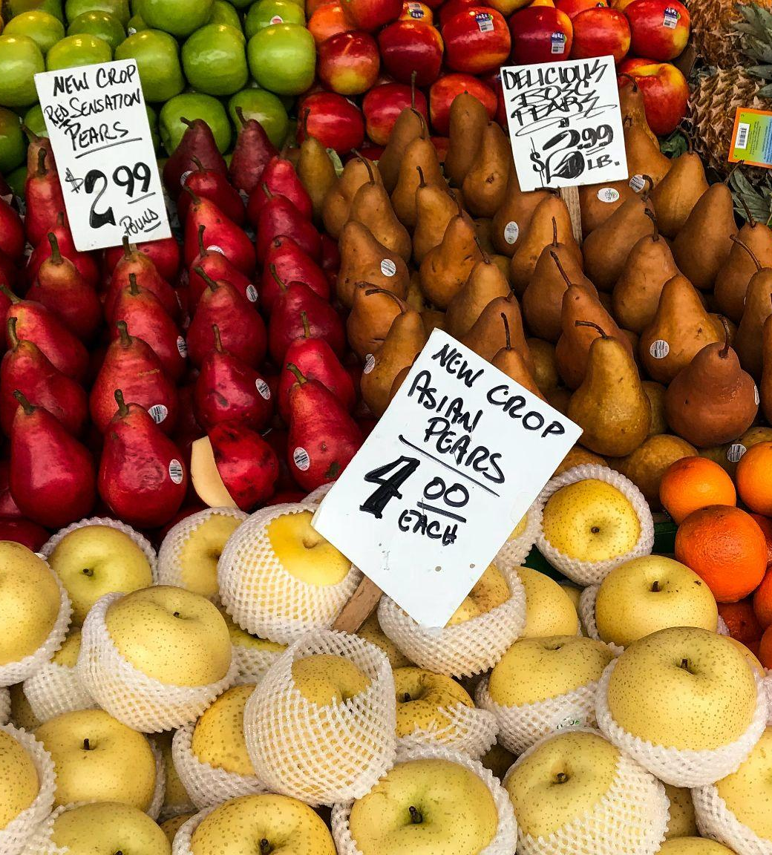
Cost assessment
The costs related to open access to research data are eligible as part of the Horizon Europe grant - refer to your Grant Agreement conditions.
For further information, see OpenAIRE guide on cost in research data management
Photo by Rajiv Perera on Unsplash

Slide 44
References
DMP Tool: https://dmptool.org/general_guidance#metadata-data-documentation
How to Guides DCC: https://www.dcc.ac.uk/guidance/how-guides
Five steps to decide what data keep: https://www.dcc.ac.uk/guidance/how-guides/five-steps-decide-what-data-keep
Adapt your Data Management Plan. A list of Data Management Questions based on the
Expert Tour Guide on Data Management: https://www.cessda.eu/content/download/4302/48656/file/TTT_DO_DMPExpertGuide_v1.2.pdf
Practical Guide to the International Alignment of Research Data Management - Extended Edition, 2021, 10.5281/zenodo.4915861
OpenAIRE guide on cost in research data management, https://www.openaire.eu/how-to-comply-to-h2020-mandates-rdm-costs
Making Your Code Citable, https://guides.github.com/activities/citable-code/
Setting up an Organised Folder Structure for Research Projects, http://nikola.me/folder_structure.html
TILS Document Naming Convention, http://www.data.cam.ac.uk/files/gdl_tilsdocnaming_v1_20090612.pdf
FAIRsharing, https://fairsharing.org/standards/

Slide 45
References
RDA, Metadata Standards Directory Working Group, http://rd-alliance.github.io/metadata-directory
Ghent University web guide on Research data management: https://www.ugent.be/en/research/datamanagement
Reading University web guide on RDM: https://www.reading.ac.uk/research-services/research-data-management
Francesca Di Donato, & Emma Lazzeri. (2021, October 18). Data Management. Zenodo. https://doi.org/10.5281/zenodo.5593104
OpenAIRE infographic on RDM costs: https://www.openaire.eu/rdm-researcher-costs-infographic/view-document
Cambridge University, Data Management Guide: https://www.data.cam.ac.uk/data-management-guide

