Slide 1
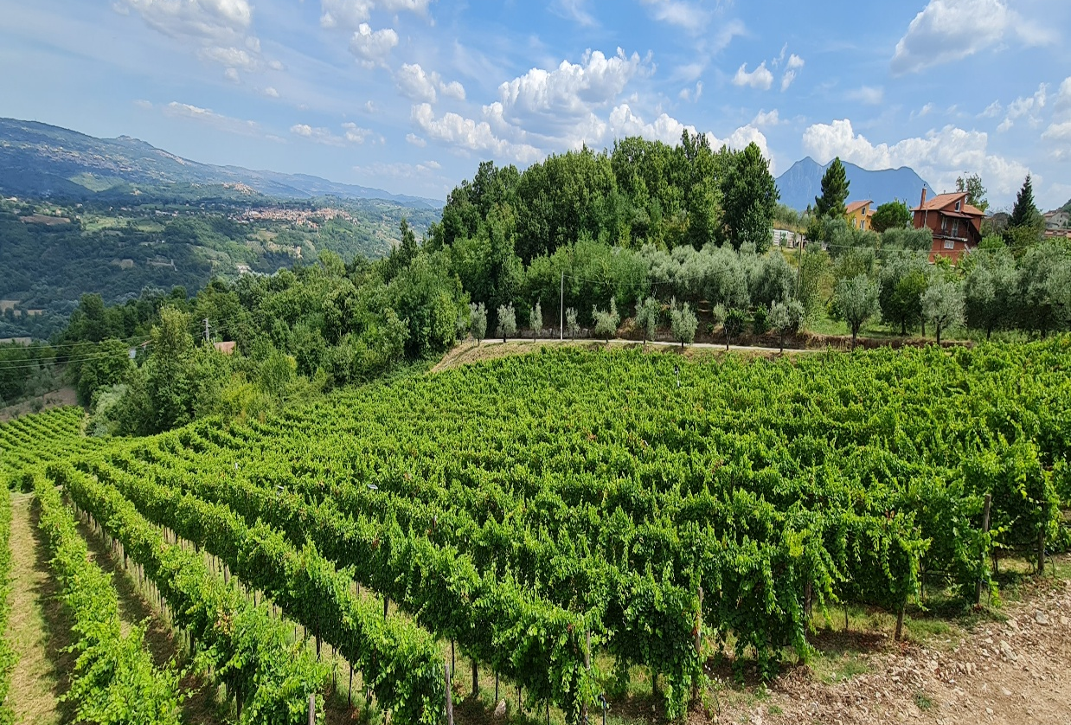


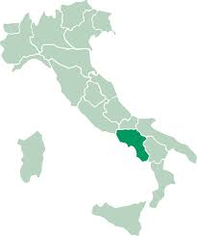






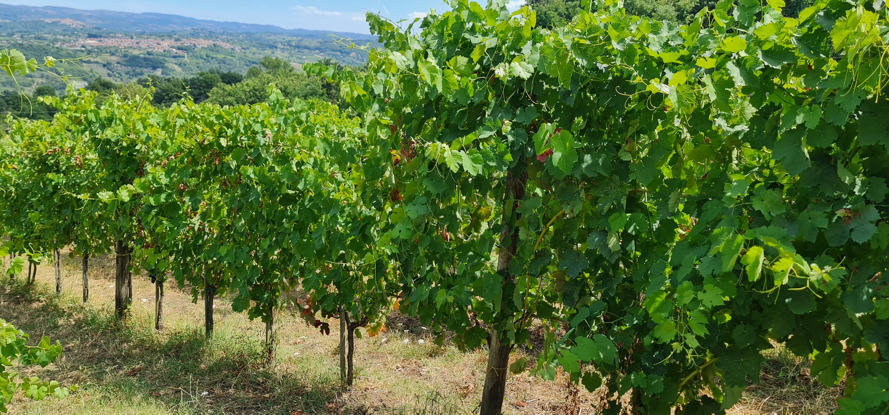
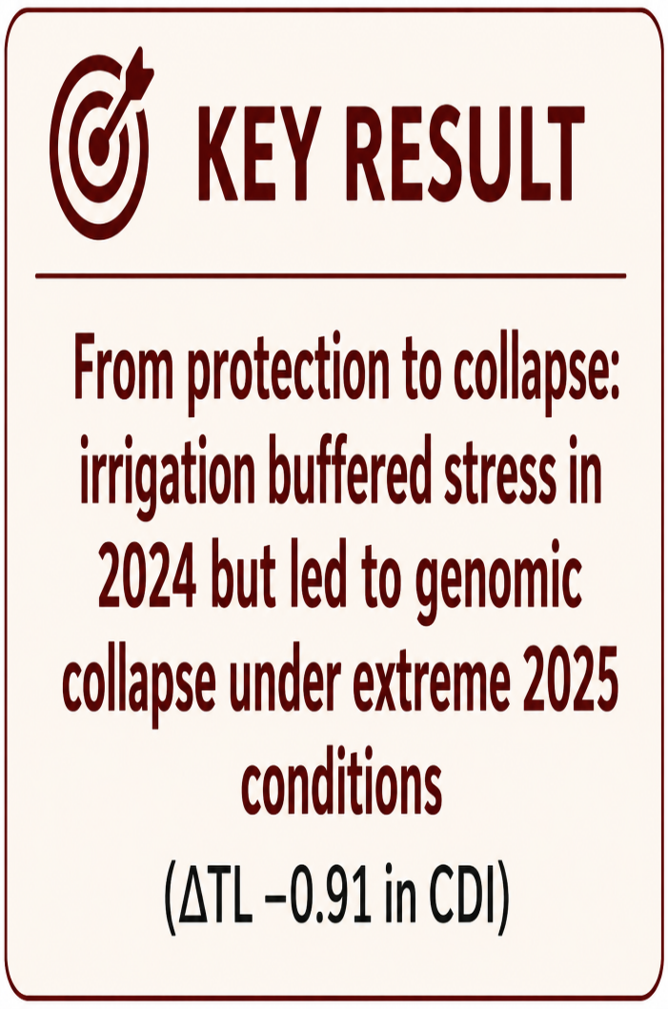
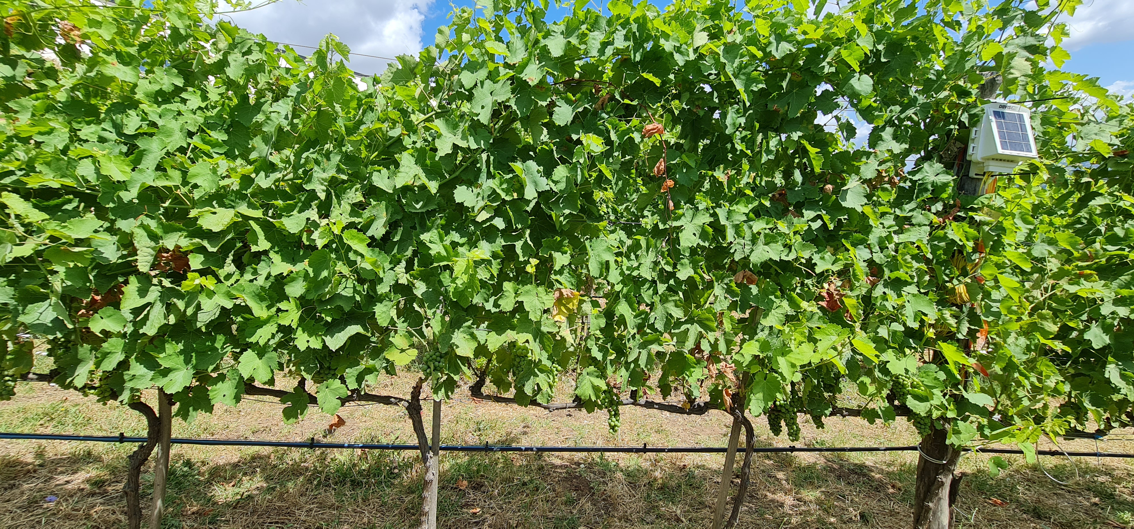
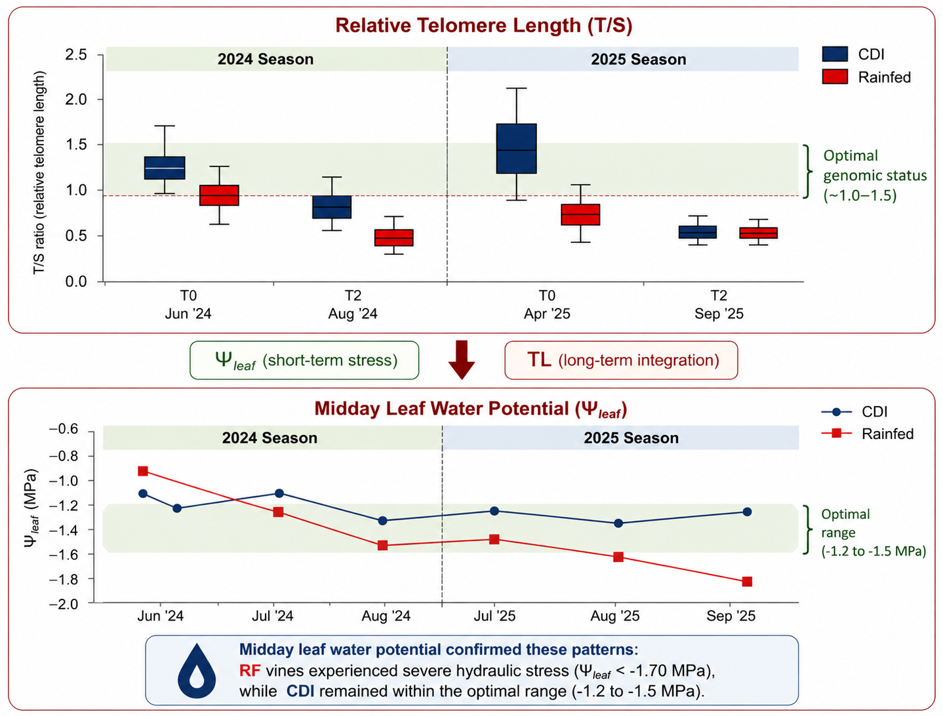
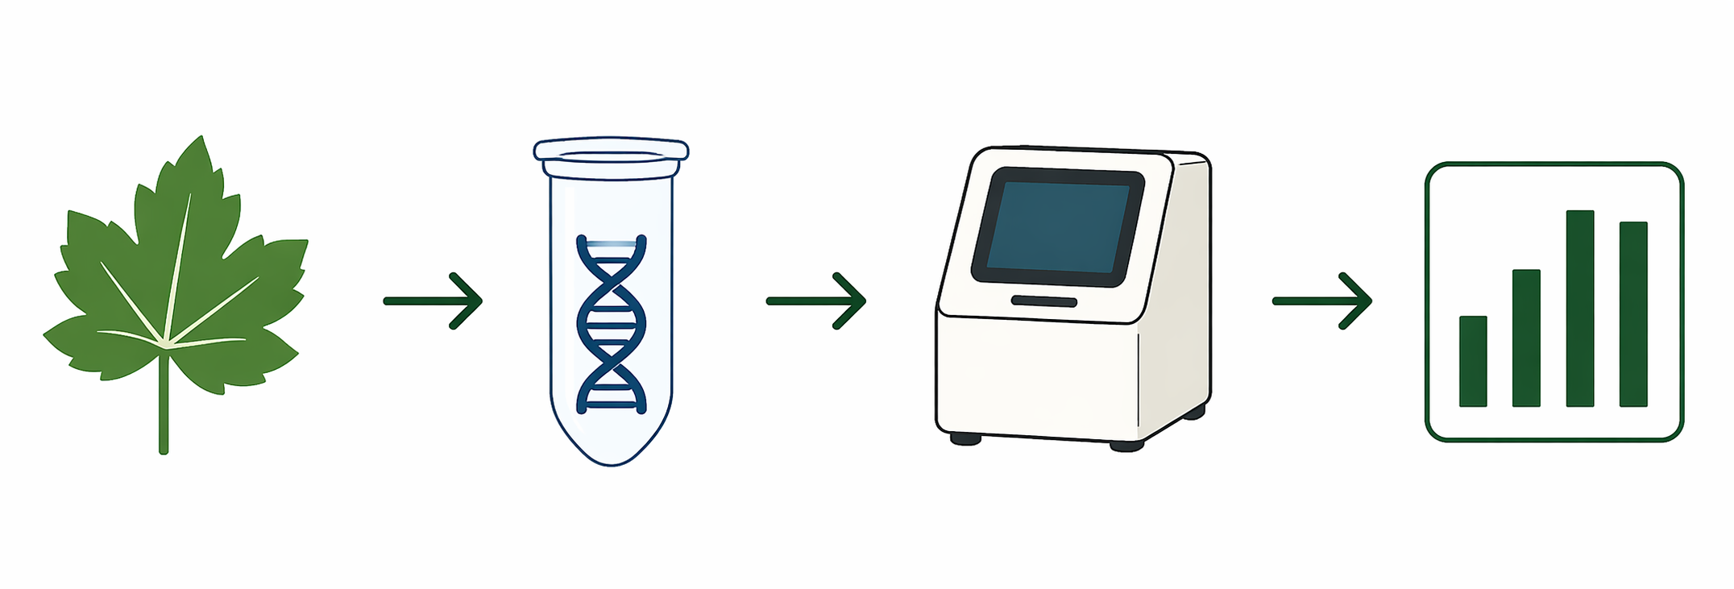

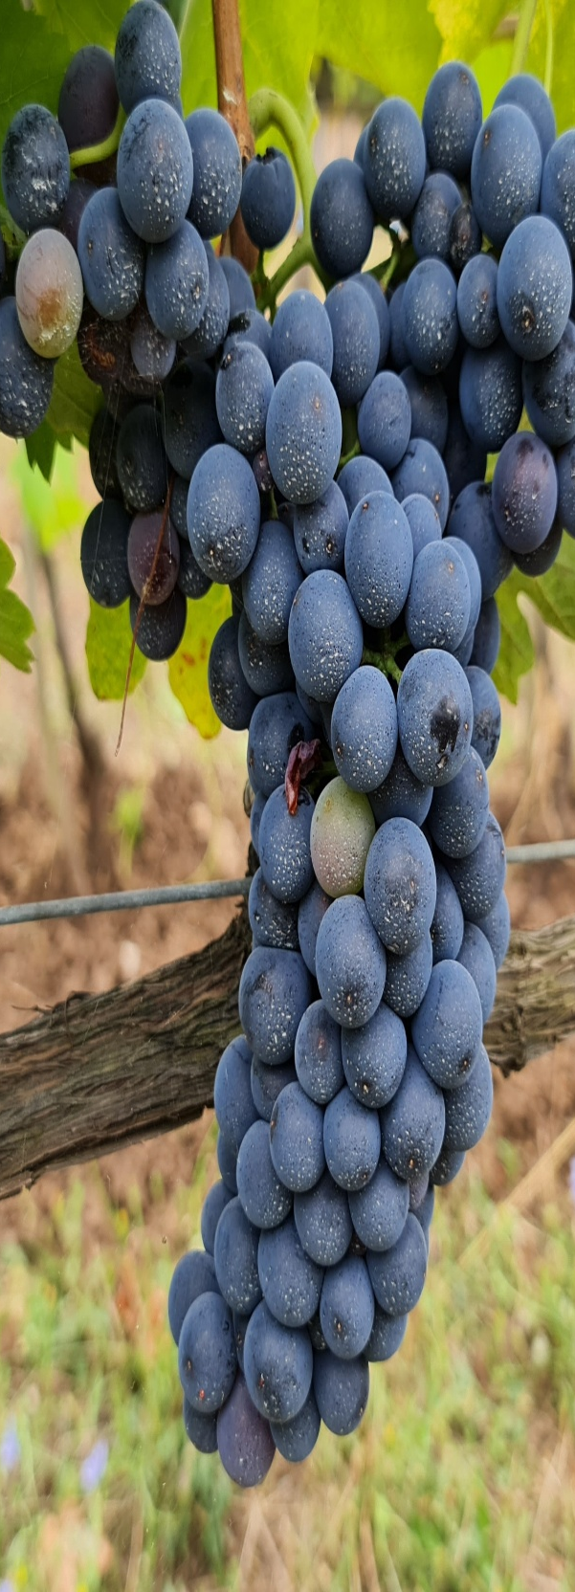
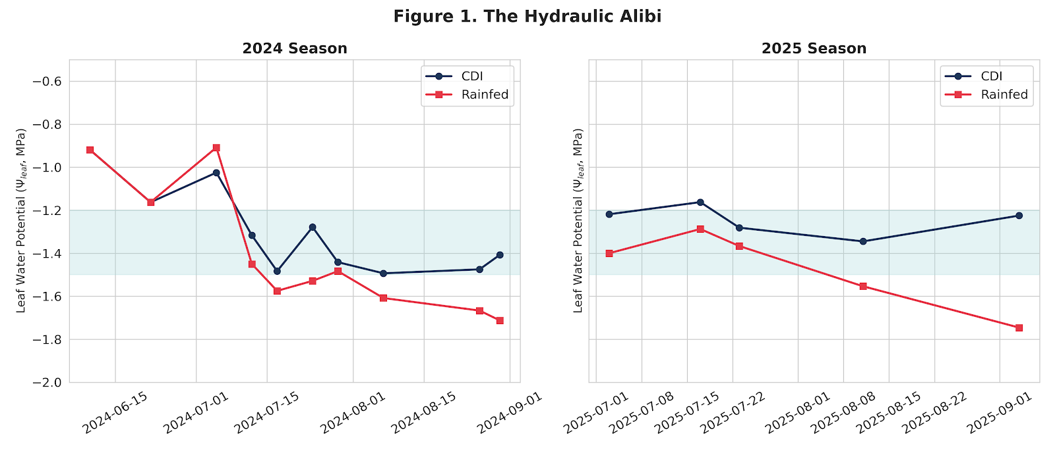

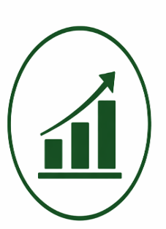





Telomere Length as a Genomic Biomarker of Well-Being in Grapevines: Current Progress in a Multi-Year Study on Aglianico Under Varying Water Conditions.
Study Site
Tenuta Donna Elvira
Montemiletto (AV) – italy
Taurasi DOCG
Iannuzzi Alessandra¹, Pistucci Ramona¹, Erbaggio Arturo², Albrizio Rossella³, Accomando Filippo³, Buonanno Maurizio³, Bonfante Antonello³
¹National Research Council of Italy (CNR), Institute for Animal Production System in the Mediterranean Environment, ISPAAM, 80055 Portici, Italy
²Freelance
³National Research Council of Italy (CNR), Institute for Mediterranean Agricultural and Forest Systems, ISAFOM, 80055 Portici, Italy
TELOMERE LENGTH (TL)
CLIMATE CHANGE
GENOMIC BIOMARKER
AIM
as a genomic biomarker of well-being in grapevines under water stress
Increase water stress in vineyards
TL as a rapid, low-cost genomic biomarker of vine physiological status
Evaluate TL dynamics in CDI vs rainfed vines
1. CONTEXT & STUDY SITE
3. RESULTS
4. DISCUSSION
Aglianico vines in Taurasi DOCG - Italy
Telomere length (T/S) captured cumulative plant stress.
In 2024, CDI vines under controlled irrigation showed lower decline (ΔTL −0.35) than RF (ΔTL −0.62).
In 2025, under daily ad libitum irrigation, CDI showed the strongest TL drop (ΔTL −0.91).
Both treatments converged to similar values (~0.60).
Irrigation regime strongly modulates vine resilience and stress response under climate extremes.
Uniform soil conditions
TL is a sensitive and integrative biomarker of vine physiological status
Rainfed vs CDI
TL reflects cumulative physiological impact, not immediately visible at initial point
Four sampling time points: T0 –T2 (2024) and T0 – T2 (2025)
Correlation with flowering time suggests links with adaptive responses
2. METHODOLOGY
5. FUTURE DIRECTIONS
Validate the protocol on multiple cultivars
LEAF SAMPLING
Young leaves collected at T0 (Spring) and T2 (Harvest)
DNA EXTRACTION
High-quality genomic DNA
dPCR ANALYSIS
EVA green chemistry primers for telomsingle-copyeric (T) and gene (S)
DATA ANALYSIS
Relative telomere length (RTL) calculated as T/S ratio (DDCt method)
Test under diverse environmental conditions
Develop TL as a tool for vine health monitoring and precision viticulture
RTL= ratio of telomere repeats to single-copy gene (T/S ratio)
Higher values indicate longer telomeres (better cellular status)
Telomere length is a powerful biomarker of water stress in grapevines, with potential applications for sustainable viticulture.

